Slide 1
Cubist Still Life
Art 2/Adv. Studio

Slide 2
What is Cubism?
*Style of art that came to being in the early 1900s
*One of the most influential art styles of the century
*Comes from the real, but characterized by straightened edges and angles, flat shapes, distorted colors/values, and multiple vantage points (“Abstraction”)
*Pablo Picasso, Georges Braque, Juan Gris, Paul Cezanne

Slide 3
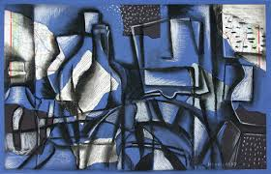

Slide 4
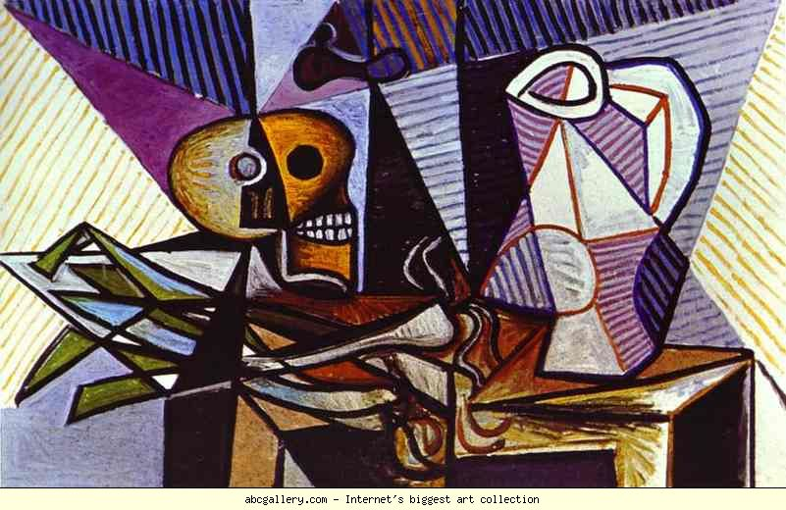

Slide 5
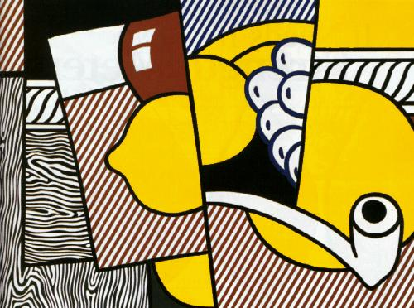

Slide 6
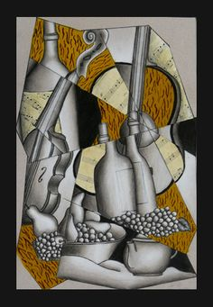

Slide 7
Your Assignment: Set-Up
*You will begin by creating an series of observational drawings of the still life set up for you.
*Try to get a variety of source material to work from.
*Try to do a variety of cropping/points of view.
Your compositions should take up most of the page.

Slide 8
Planning!
*It’s vital that you plan for this project.
*Do not skip the observational thumbnail sketching
*You need to have a final sketch and get my approval before getting the final paper

Slide 9
Set Up: Abstraction
*Physically cut up your sketches into several big pieces, then re-arrange and put them back together to help you form a new, abstracted composition. Move the pieces around and play with them until they are to your liking.
*You can simplify/distort edges and details, play with alignment/transparency/repetition etc. Look for major forms as well as reflections/distortions.

Slide 10
Your Assignment: Set-Up
You will work on 16 x 16 paper. You will apply a newspaper to your paper. Cut out several big shapes from newspaper and glue them on to the white paper. This “ground” should be applied to all four sides as well as the center to help balance. You will work right on top of this ground as your new surface.

Slide 11
Composition
*Transfer your sketch (you may change the composition to suit the paper, if needed) to your final paper. Work right over the newspaper.
*You can simplify/distort edges and details, play with alignment/transparency/repetition etc. Look for major forms as well as reflections/distortions.
*Utilize a series of lines to “chop up” your composition into several sections.
*Tracing over major outlines and chop lines will help you achieve that Cubist look.

Slide 12
Medium
*We will be using water-soluble graphite for this project (“Sketch and Wash” pencil). {we’ll have a review/demo lesson}
*You will need to display a range in value (contrast/gradation) and use the pencil in both wet and dry fashion.
*The values do not have to be observed from real life.
*You may create designs/patterns in the shapes (esp. background)
*You may work in color with colored pencil after the graphite is complete.
*You can also continue to develop details, repeat patterns etc. in marker.

Slide 13
What am I Looking For?
*Composition is balanced and unified: Even distribution of dark and light areas, shapes “flow” and the eye moves around the page
*There is observation and abstraction (we know what we’re looking at, but it has been altered and made more interesting)
*Make it look GOOD! And have FUN!

Slide 14
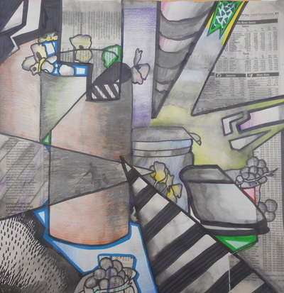

Slide 15
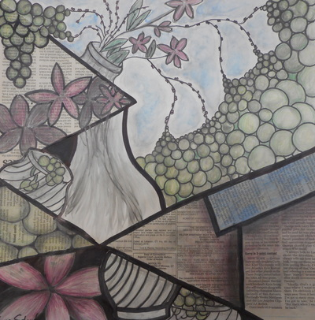

Slide 16
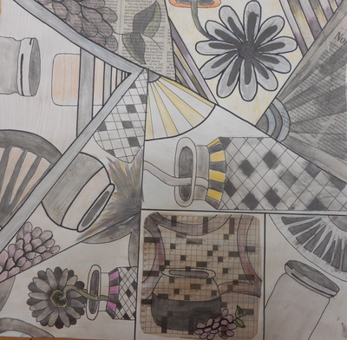

Slide 17
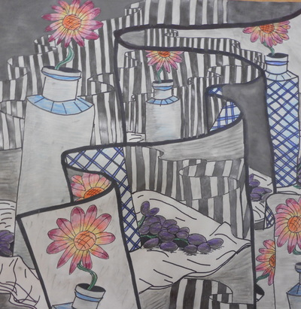

Slide 18
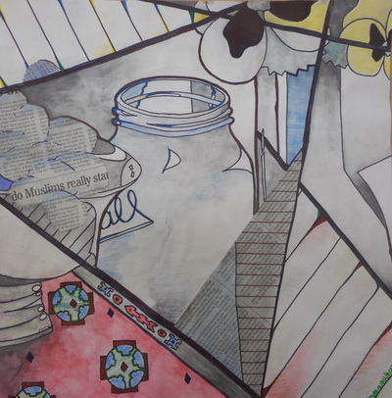

Slide 19
Due Date Information
*You will have FIVE classes to work on this project:
Day One- preliminary sketching
Day Two- Setting up new abstracted composition; applying newspaper; transferring to final paper
Day 3-5- Applying media
Work is due: October 23rd

