Slide 1
Line Design
ART 1

Slide 2
Lines and shapes
A line: An element of art defined by a point moving in space. Lines can have different weights (thick or thin)
A shape: A two-dimensional area or plane that is closed.
A shape is created when lines connect

Slide 3
Patterns
A pattern: A repeated line or shape
In each shape you create on your paper, you will fill with patterns.
Each shape must be filled with a different pattern and there cannot be any white-space larger than a lima bean

Slide 4
Rhythm + Variety
Rhythm: Repetitive visual elements that achieve a specific effect.
Variety: A principle of art concerned with combining one or more elements of art in different ways to create interest.
In this project, you are combining lines, shapes, and values in order to create rhythm and variety.

Slide 5
Value
Value: Lightness or darkness of a hue or neutral color.
During this project, try to create a variety of different values throughout the paper so when you step back and look at it, you see darker and lighter areas, giving visual interest.

Slide 6
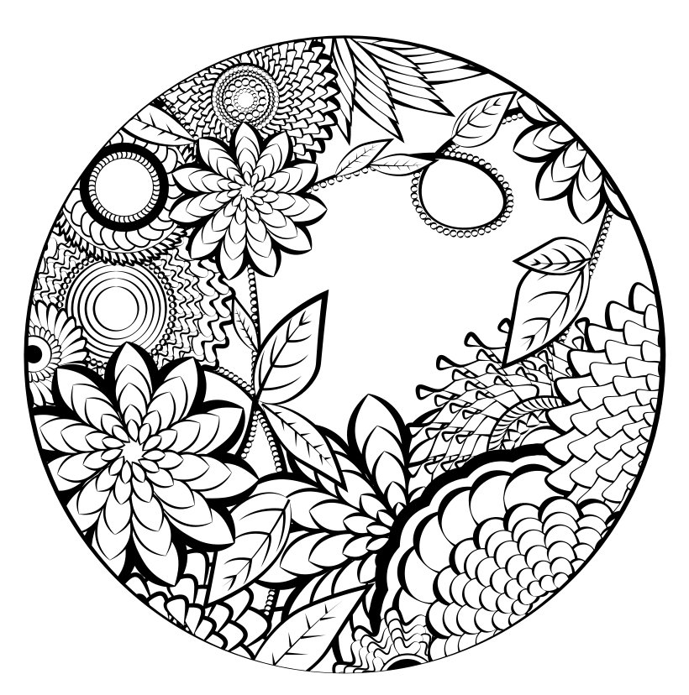
Your eyes move around the page because they see variations of value, giving interest to the piece of work…

Slide 7
Due Date Information
This project needs to be handed in with a completed rubric (front and back) on A days: Sept 18. B days: Sept 19
If I see that the entire class needs extra time, it will be given. However, extra time is given ONLY if I see the entire class working consistently.
Every day the project is turned in late, it’s 5 points off. After 2 weeks, the project is a 0.
If a project is turned in without a name on it and/or the project isn’t turned in with a completed rubric, it’s 10 points off.

Slide 8
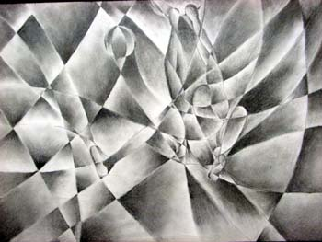
Value Collage (part 2)
Art 1

Slide 9
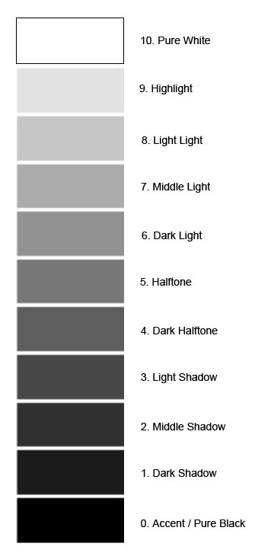
Value Scale
The value scale goes from 0=black to 10=white.
When we gradually create value, we don’t want to see the lines where we go from black to dark grey to light grey. We try to do our best to blend in the gradation so it looks subtle.

Slide 10
Only shapes and no outlines…
We shouldn’t see any lines when we’re done giving value to all of the shapes in our work. The lines go away because value is what creates the shapes, not a line.
*hint: When creating value, squint at your drawing and if you only see blended value, you’re doing a great job. If you see a value sticking out or a line, try blending it in.

Slide 11
Observe the edges of this cube. The cube is not outlined, the planes of the cube are different values which creates the 3D form. Think of this cube when you create the value in each of the shapes.

Slide 12
Due Date Information
This project needs to be handed in with a completed rubric (front and back) on A days: October 2. B days: October 3
If I see that the entire class needs extra time, it will be given. However, extra time is given ONLY if I see the entire class working consistently.
Every day the project is turned in late, it’s 5 points off. After 2 weeks, the project is a 0.
If a project is turned in without a name on it and/or the project isn’t turned in with a completed rubric, it’s 10 points off.

