Slide 1
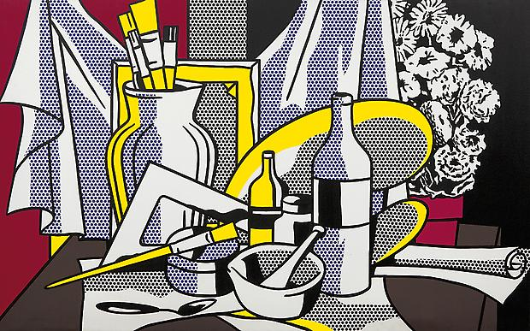
Pop Art Symbolic Still Life
Art 2

Slide 2
What is Pop Art?
The subject matter of Pop Art comes from things that are well-known and popular (cartoons, advertising, celebrities, mass-produced items etc.)
Pop Art came to being in the 1960s.
Andy Warhol is probably the most well-known Pop artist. Warhol is known for using bright, flat colors, bold shapes, and contrast between color and black to create images of celebrities and common products.
Roy Lichtenstein is another well-known Pop artist. His style was directly influenced by comic books. Lichtenstein is known for using simplified shapes, bold outlines, and limited colors (usually primary colors). He also used dots and lines to suggest shading and form.

Slide 3
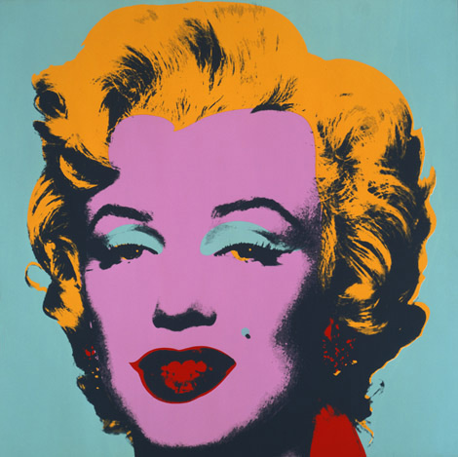
Andy Warhol- Marilyn 1967

Slide 4
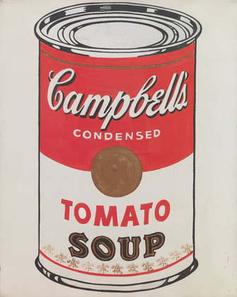
Andy Warhol- Campbell’s Soup Cans 1962

Slide 5
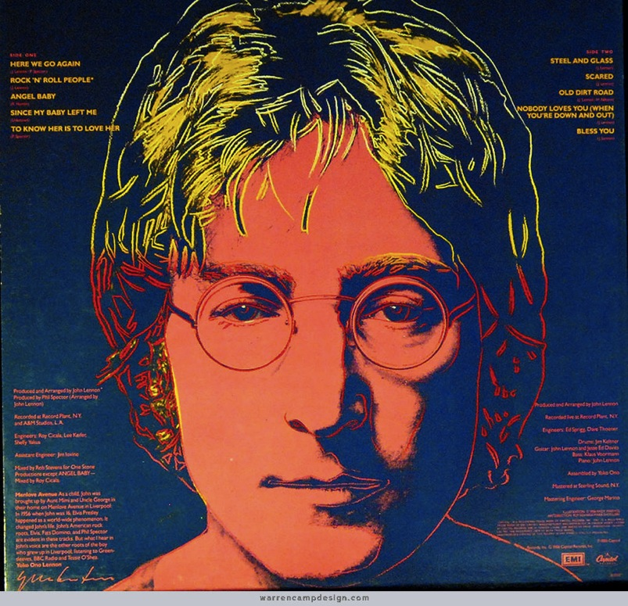
Andy Warhol- Album Art

Slide 6
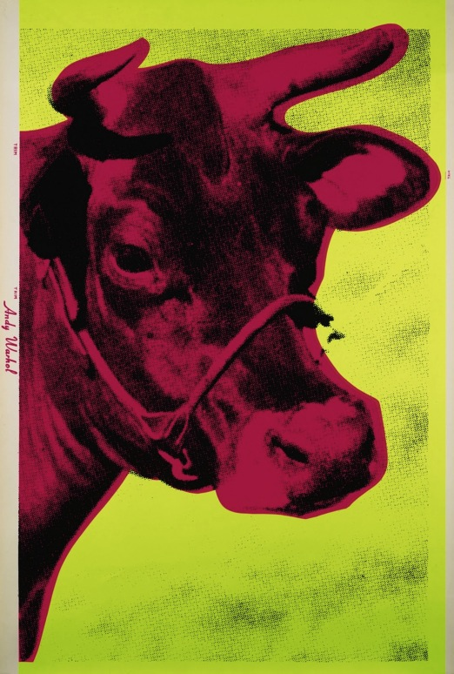
Andy Warhol

Slide 7
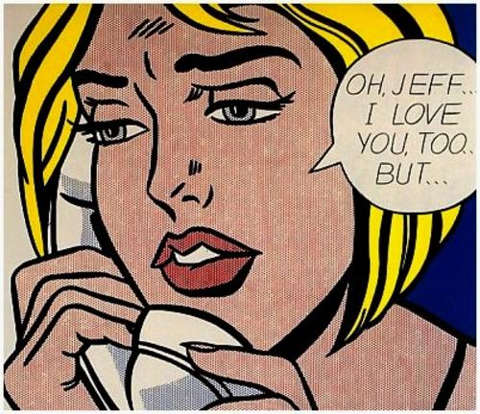
Roy Lichtenstein

Slide 8
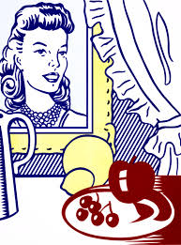
Roy Lichtenstein

Slide 9
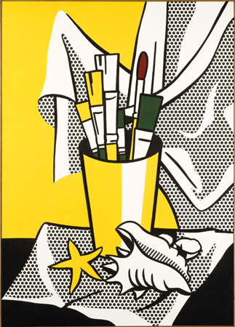
Roy Lichtenstein

Slide 10
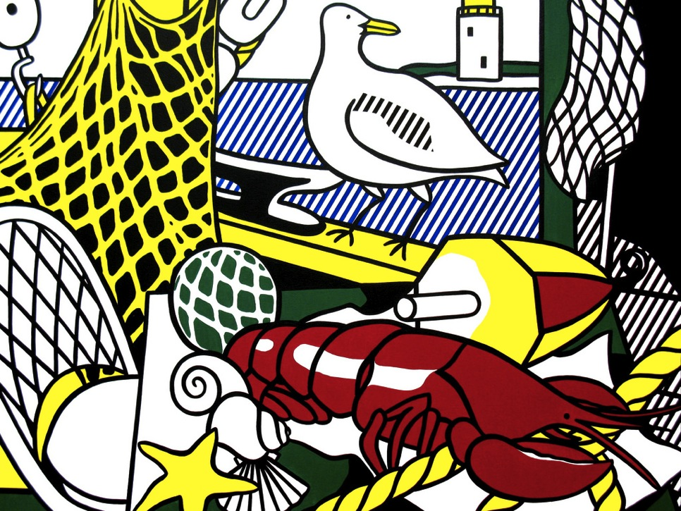
Roy Lichtenstein

Slide 11
Your Assignment
You will be creating a still life painting using tempera paint. You will borrow elements of the Pop Art style in your work such as bold colors, flat shapes, and strong outlines.
The still life subject matter (the objects you choose) will have been brought in by you. Try to focus your objects around the theme of identity and/or nostalgia.
Unlike the Cubist still life, the Pop Art still life will be less abstract in set-up (you will be arranging the objects on your page more closely to what you see).

Slide 12
Preparation
We will have a few days of set-up. One class will be spent reviewing painting techniques and practicing with tempera.
Another class will be spent making practice studies of your chosen objects.
You will need to arrange the objects so they create a strong still life. Triangles are strong shapes. Have objects touching, but not clustered too close together. Try to have the eye flow around the objects, and have the arrangement be visually balanced.
You will also be making a sketch of your still life once it is arranged to help determine composition.
Your objects should use the space on the page well. Be sure that the objects are grounded with a surface, and resolve the background in your work.

Slide 13
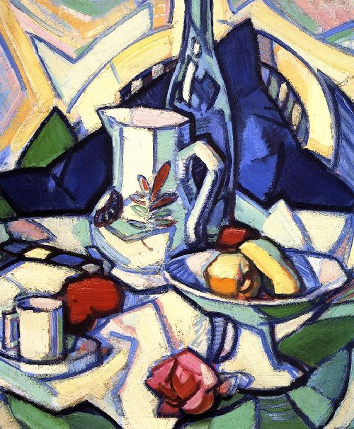
A Strong Composition

Slide 14
Set-Up/Procedure
Block out the drawing/sketch lightly using pencil on the final paper (12x20).
Trace your pencil lines using a thick black marker or black tempera paint.
Paint inside the shapes. You don’t have to be completely literal with color, but you can if you want to.
You can use lines and dots to describe form and add visual interest, as well as add highlights/shadows.
Mix colors completely, and paint with neat, bold, flat shapes. You may need to use two coats on some colors.
When you’re finished, you can touch up the black lines, if needed.

Slide 17
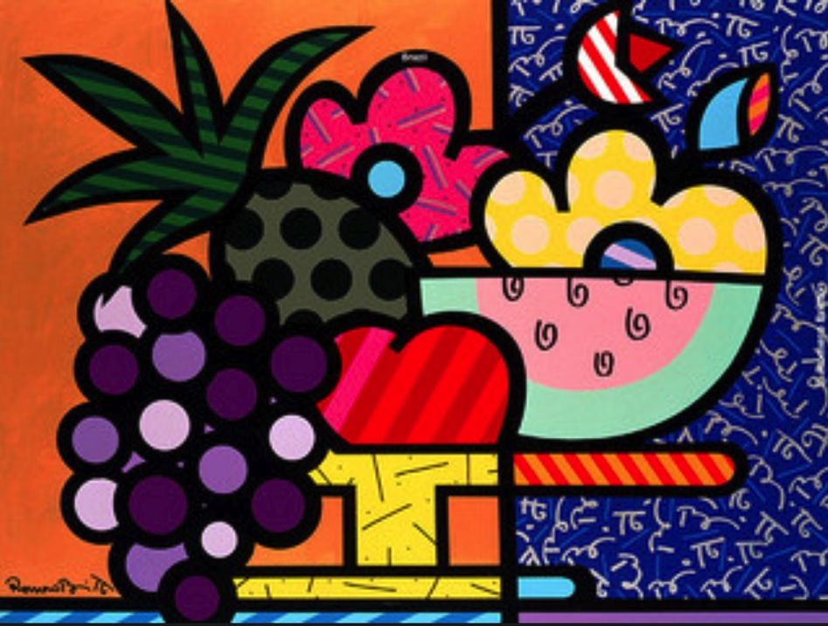

Slide 18
Project due with rubric completed (BOTH sides) December 22nd.
No rubric/incomplete rubric? 10 points off.
Work looses 5 points for each day it is turned in late. No work accepted after two weeks late without prior teacher approval. If you’re behind, come in for extra time and catch up!

