Slide 1
Slab House
Ceramics 1

Slide 2
What kind of house?
Decorative (holiday is an option too!)
Fairy house
Bird house
A house you can put lights/candles in
Be creative! Many options available…
You should have a theme!

Slide 3
Round or Square/Rectangle
You can create a round or square house
A round house you’d make similar to the mug but you’ll need to make a cone roof (can be challenging but do-able)
A square/rectangle house will need templates so you make the sides the same size/shape
This is a more difficult choice to making a house so if your craftsmanship hasn’t been great, this may not be the best choice
You would make 1 template for front + back
1 template for the sides
Roof you’d work with after you’ve constructed the structure

Slide 4
Most of the houses don’t need a base
Why wouldn’t we want one? The base can warp if you’re not careful about transporting or storing on a flat surface
Why would you want one? If your house is more complex and you want all of the walls to be connected in some way. Or if you are making a bird house, obviously it needs a base ☺
You need to make the decision of how to construct this project. It is the last big project of the semester! Show me your skills

Slide 6
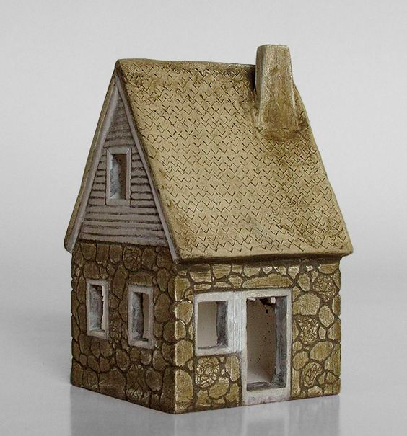

Slide 7
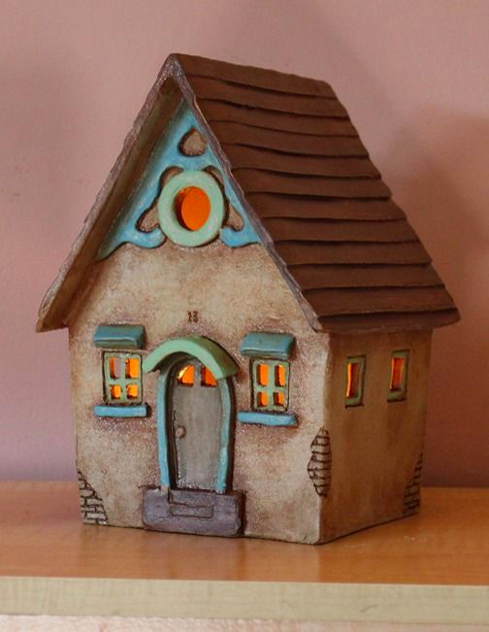

Slide 8
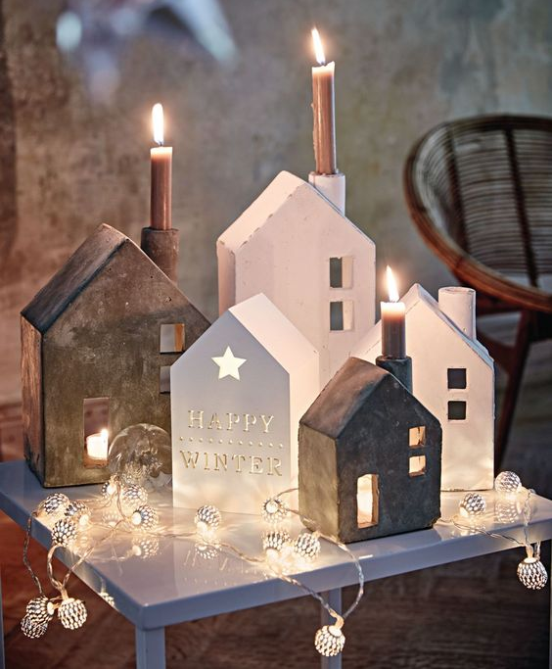

Slide 9
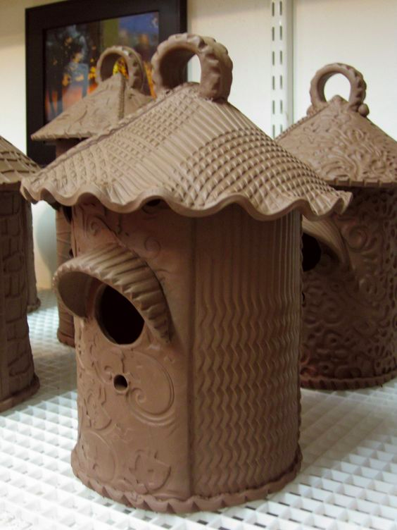

Slide 10
What the house needs
Roof with texture
Windows (either cut out or carved in/built out)
Be careful how you cut! More holes=less stable structure
Door(s) with 3D elements or completely 3D
Other options:
Chimney
Greenery that is on/attached to the house
Stonework on the house
Etc. You think of something cool? Ask me!

Slide 11
How to make your house unique
Shape
Textures (bring in your own objects to make texture!)
Details
Theme
Glaze colors
Your own personal touch
* NO WORDS please….like usual

Slide 12
Dimensions
Your house should fit within these requirements
7-9 inches tall
6-9 inches wide
4-6 inches deep
This includes the chimney or other aspects you’re adding to your house!
You cannot add a yard or anything that your house is attached to…I just want a house with details
6-9 inches
7-9 inches
4-6 inches

Slide 13
Sgraffito!!
Applying 3 coats of underglaze to hard/leather hard clay (not bone dry) and then scratching onto the surface to produce an outline drawing or pattern.
You will paint aspects of your house with different underglaze colors and apply texture/patterns/designs/details by drawing into the underglaze
Whatever you draw/scratch is white after bisque firing
After bisque, we clear glaze the houses to seal everything

Slide 14
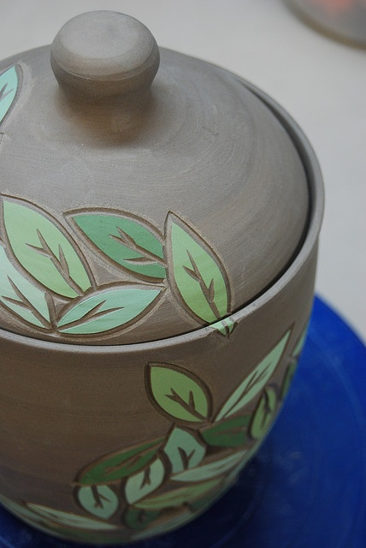

Slide 15
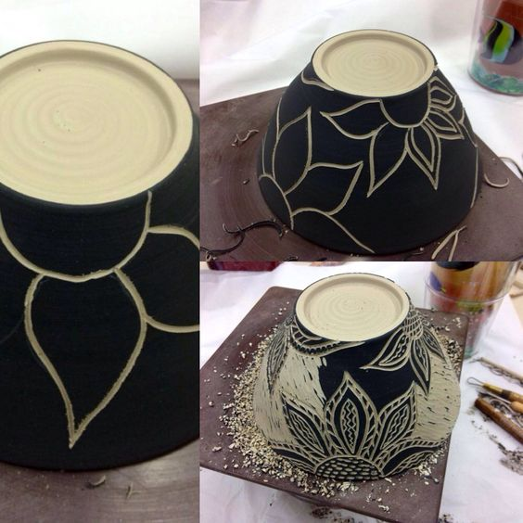

Slide 16
What I want to see
Well constructed house within the size requirements
Impeccable craftsmanship
No crummies, no canvas texture, no sharp edges, no cracks in the seams, etc.
3D aspects on all sides
Creativity and individuality
Experimentation and genuine effort
Pushing your ability and choosing to do something challenging but do-able. Not doing something easy (don’t think I don’t hear some of you saying that)
Sgraffito is applied well-there is a good amount of it but it doesn’t take away from the form/concept of the house

Slide 17
Due date
Your house should be completely constructed, sgraffito is applied and ready to drape in order to dry slowly no later than:
4A: December 11
4B: December 12

