Slide 1
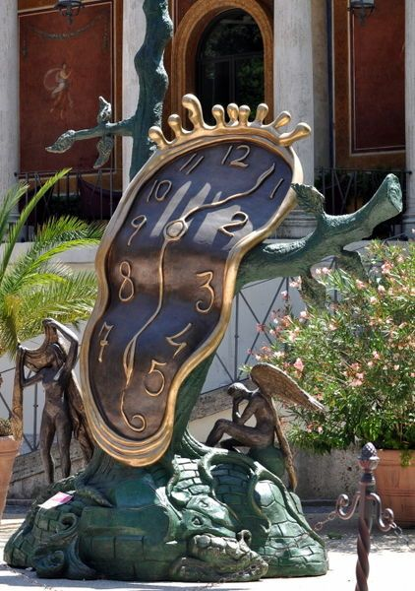
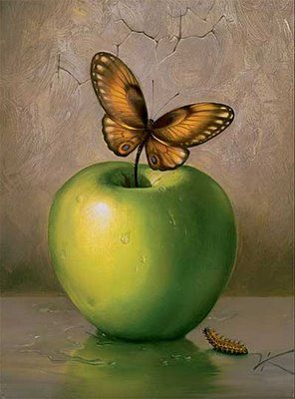
Surrealist Paper Sculpture
Group Project: Art 2 + Advanced Studio

Slide 2
Surrealism
Originated in late 1910s to early ‘20s as a literary movement that experimented with a new mode of expression called automatic writing, or automatism, which sought to release unbridled imagination of the subconscious
Officially created in Paris in 1924 with the publication of the Manifesto of Surrealism by poet and critic Andre Breton, it became an international intellectual and political movement. https://www.renemagritte.org/link.jsp
Sigmund Freud was profoundly influential for Surrealists, particularly his book, The Interpretation of Dreams (1899). Freud legitimized the importance of dreams and the unconscious as valid revelations of human emotion and desires: his exposure of the complex and repressed inner worlds of sexuality, desire, violence provided a theoretical basis for much of Surrealism. http://www.theartstory.org/movement-surrealism.htm

Slide 3
Objective
You will be placed into 6 groups of 3 students. It is imperative that you are here in class every day so you are able to productively work with your partners. Students who miss class time will ultimately have a lower grade than the rest of their group.
In life you need to learn how to work with people you wouldn’t normally work with. I’ve spent a lot of time thinking about which students will work well together but also bring different strengths to the table. The groups are not up for discussion and will not be changed. You are older, advanced art students-you will figure it out.
Your group will choose one of the following images to be inspired by in order to recreate it in a 3D sculpture out of paper. You will also research about the artists and the work of art to get a better idea of who the artist is, what their philosophy was, and why the work was created.

Slide 4
Objectives cont…
Each sculpture should either be free standing, or be mounted to a board to hang on a wall.
Size requirements: between 3-5 feet tall, 3-5 feet wide, 2 feet deep
Thinking as an architect is going to need to happen!
Think about how heavy a material is, will what you want to create actually work and stand up?
A huge part of this project is making sure it actually functions as a sculpture. A pile of materials on the floor because it didn’t hold up is not acceptable.
How will this sculpture be displayed?? Hung or standing on the floor?
Use your prior knowledge and experience in art classes, wood shop classes, etc. Art 1: paper mache projects, Ceramics: EVERYTHING

Slide 5
Materials
Cardboard of various shapes, sizes, thicknesses
Plastic containers, plastic bags
Construction paper, newspaper, tissue paper
Wire, string
Acrylic paint
Hot glue, Elmer's glue, glue sticks, wheat paste
It’s encouraged that you bring items from home! I will provide as much as possible but if there’s something specific you need, you are responsible to get it.

Slide 6
Surrealism Controversial Work
Surrealist artwork is inspired by the notion of the subconscious. This includes sexual, violent and/or political concepts.
When you are going through websites researching about the artist and work you have chosen, please be aware that you may see slightly disturbing or nude imagery.
You are expected to be responsible, mature 11th and 12th grade students. Any type of rude, inappropriate behavior that does not belong in a classroom will be reported to Mr. Buonocore to address.
You are also expected to create a work of art that is school appropriate! Nudity, violence, etc. is not allowed.

Slide 7
Questions?

Slide 8
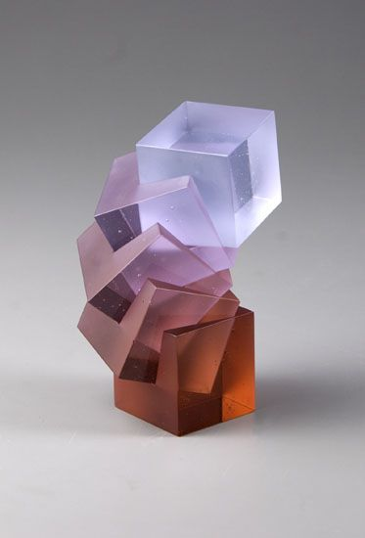
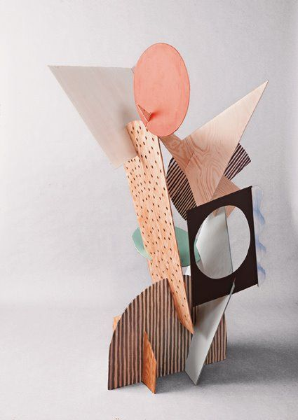
Examples of Sculpture

Slide 11
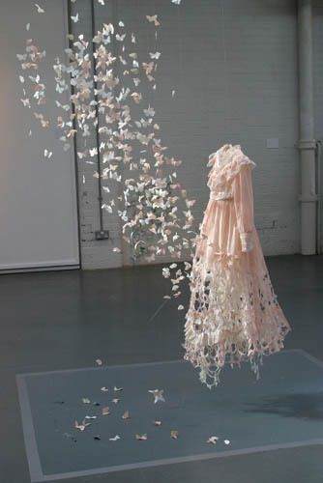

Slide 12
Groups
1: Mahailya, Erika, Aidan
2: Libby, Seamus, Bellana
3: Thomas, Ellie, Devin
4: Ian, Emma, Sabrina
5: Brandon, Grace, Tia
6: Elijah, Lily, Rilee
Your group name will be the work of art you choose. At this time, get together with your group. As we go through the following artwork, write down 3-4 pieces of work you like the best.

Slide 13
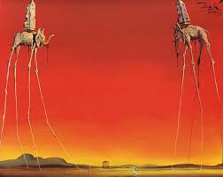
Salvador Dali
The Elephants, 1948 oil on canvas

Slide 14
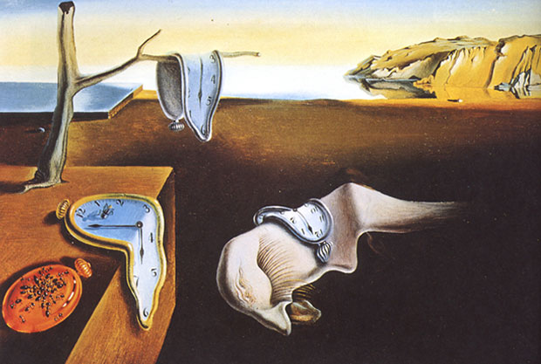
The Persistence Of Memory, 1931 oil on canvas

Slide 15
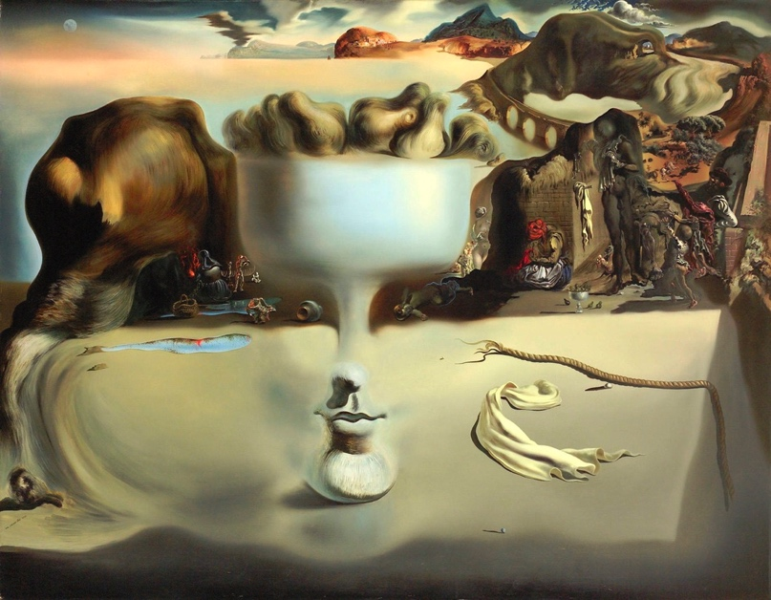
Apparition of a Face and Fruit Dish on a Beach, 1938 oil on canvas

Slide 16
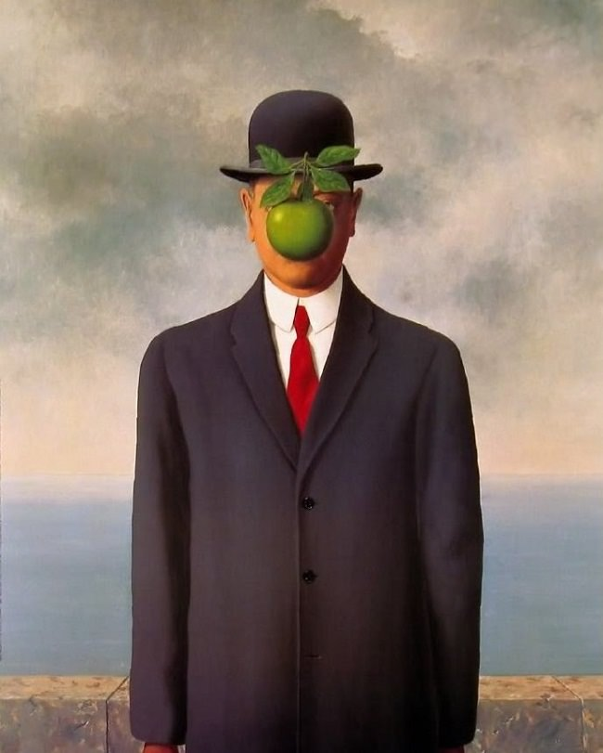
Rene Magritte
The Son of Man, 1946

Slide 17
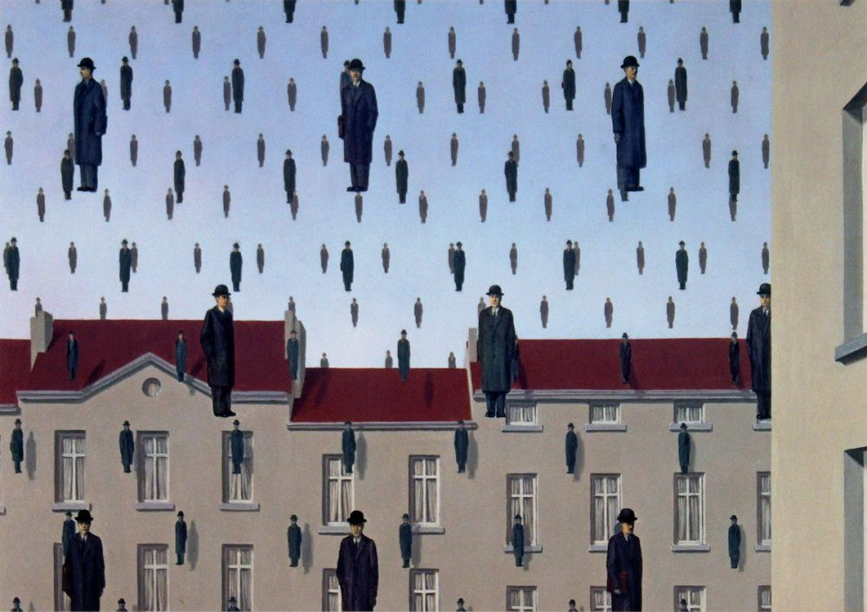
Golconda, 1953

Slide 18
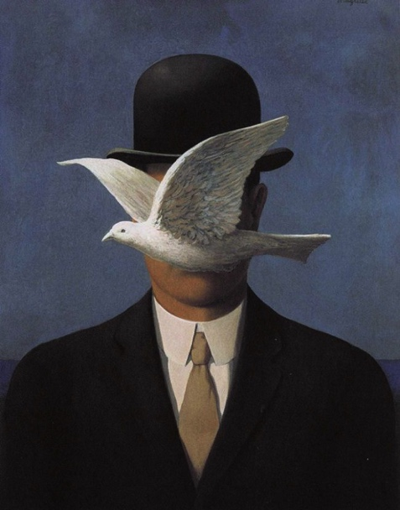
Man in a Bowler Hat, 1964

Slide 19
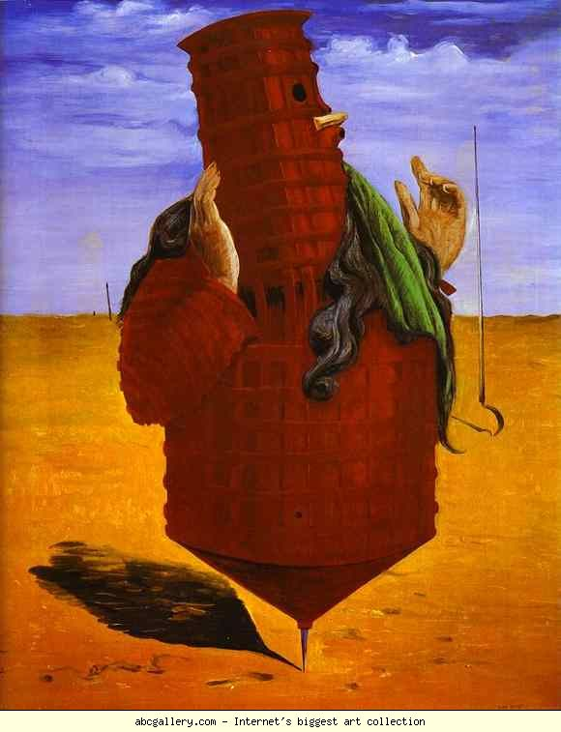
Max Ernst
Ubu Imperator, 1923

Slide 20
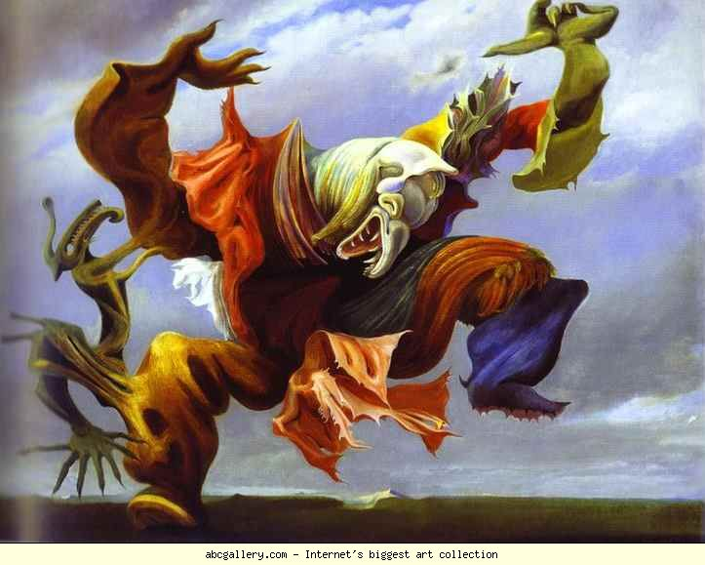
L’Ange du Foyer, 1937

Slide 21
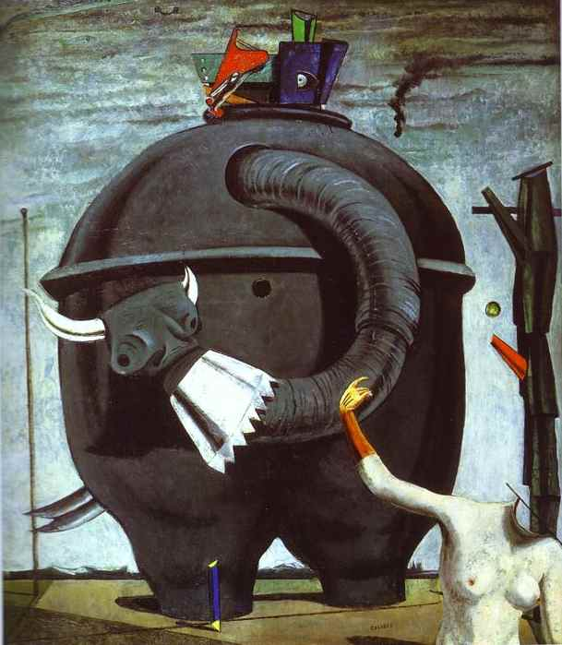
The Elephant Celebs, 1921

Slide 22
Next step…
You’re going to grab a “Surrealism Paper Sculpture Research/Planning Sheet” and an iPad (use your phones too) to complete the sheet. 1 sheet per group.
This sheet should take 30-45 minutes to complete because you’re going to really research about the artists and work of art you chose as well as brainstorm and plan your project. Please read all of the directions.
Keep in mind: The project should be represent surrealism in an obvious way, inspired by the work of art if not a replication of the work in 3D form.

