Slide 1
Paper Mache
Art 1 Big Head Project

Slide 2
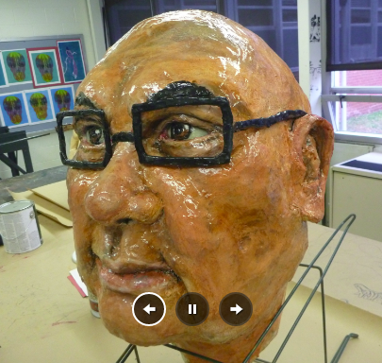
Objective
You will create, either by yourself or with a partner, an oversized head made out of cardboard and various materials.

Slide 3
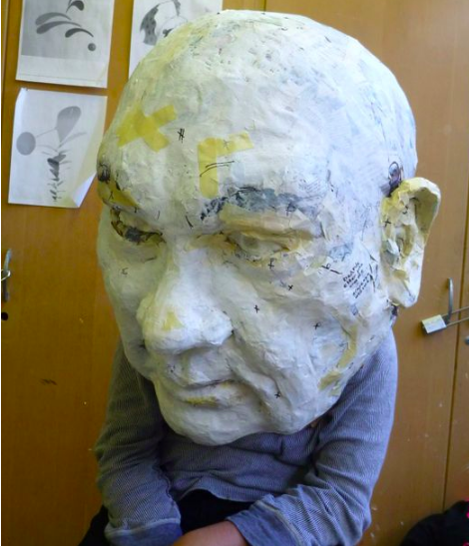
Who? What?
You are given the opportunity to create the head of anyone you’d like…but there are some requirements:
Large enough to put your head inside of: around the size of 20”x 20”
Should be realistic-looking.(eye sockets, cheek bones, etc.) We’re not creating masks, we’re creating 3D heads
A human head (no animals!)
Athlete, Artist, Celebrity (someone recognizable with obvious features)

Slide 4
Experimentation
This is a new project that is 3D and a new material.
You need to have an open mind: experiment with the notion that your first idea will probably not be successful. Structure is your #1 priority…
Use your peers as a resource! You are all going to be struggling and finding ways to be successful. So share those ideas and observations!
Google search, Youtube, Pinterest, etc. to figure out how to manipulate cardboard into what you’re planning. Your teacher is here for support but you are in charge of exploration.

Slide 5
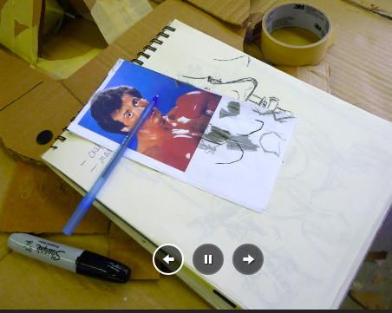
Crazy? YES!
This project is a little crazy but that’s what makes it so awesome! Check out these pictures to see how the heads can be created:
Plan:
Pick a person
Sketch
Break down face into sections

Slide 6
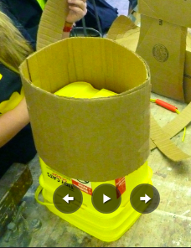
Create a base:
1. Figure out how big the neck needs to be in order to hold up the head

Slide 7
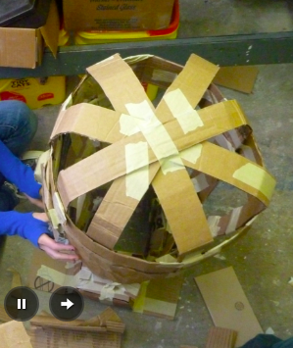
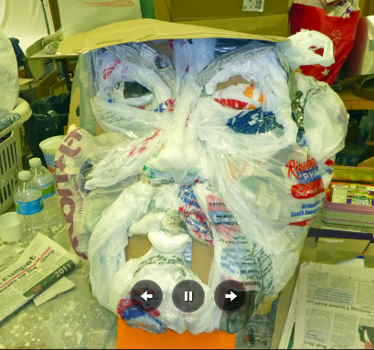
Make basic shapes:
Create the basic shape of what you’re trying to create.
Notice how some people used plastic bags for curved shapes.
Strong materials, the better like the cardboard with curves to create the top of the head.

Slide 8
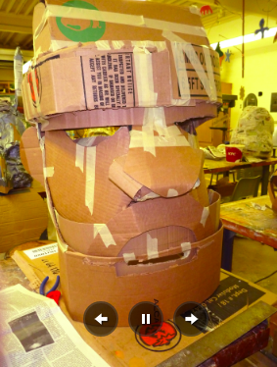
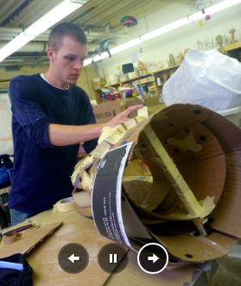
Continue creating the structure
** Stability is so important! Notice the brace on the inside of that head!

Slide 9
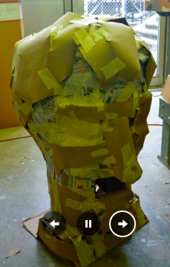
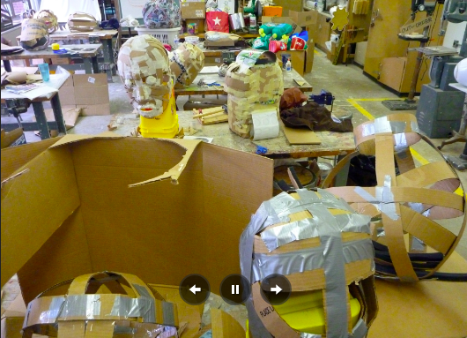
Using duct tape and masking tape to hold pieces together will help
Also use newspaper and plastic bags to create volume then use cardboard to create the actual shell of the head.

Slide 10
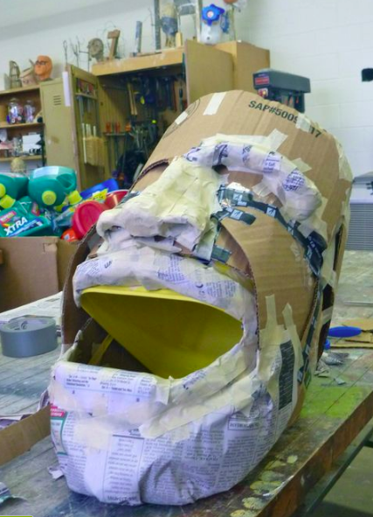
Start paper mache:
Demonstration will be given when the times comes…

Slide 11
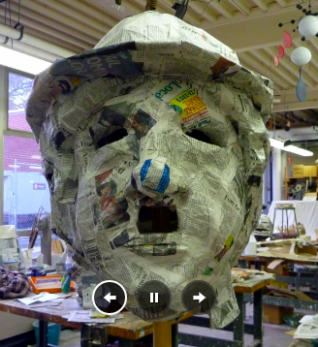
Notice how smooth the paper mache is applied. This is very important! Time and care needs to be taken when doing this step!

Slide 12
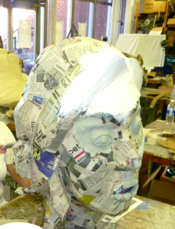
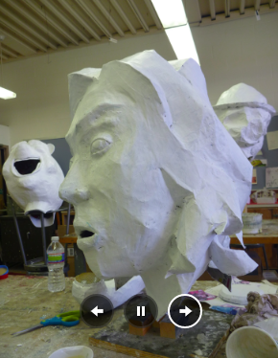
Once paper mache is done and dry, time to put on the white primer. This preps the surface to paint otherwise paint won’t cover as well

Slide 13
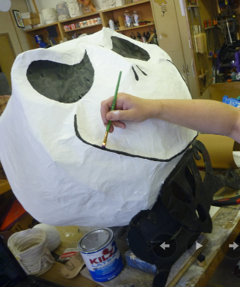
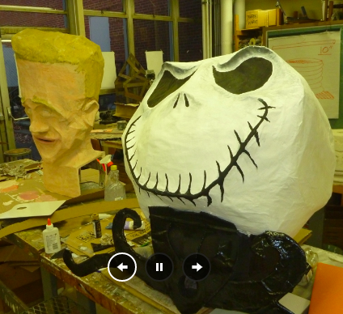
Time for paint:
You can choose to do a realistic color scheme or choose to do a monochromatic color scheme

Slide 14
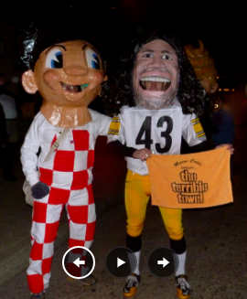
You’ll have the option to seal your project with either modge podge or clear spray paint to give it a glossy sheen.

Slide 15
We’re hoping to have these done by Arts Night: May 25th. Visitors will freak out when they see these crazy big, awesome looking human heads!
Please refer to the informational sheet given to you (and should be stapled into sketchbook) about timeline, due date, etc.
**This project will be worth 150 points**

