Slide 1
Coil Vessels
Ceramics 1

Slide 2
What is a Vessel?
A vessel is a container-an object to hold something
What can a vessel hold?

Slide 3
What is a Coil?
A forming method using rope-like coils of clay assembled in successive layers to build up walls of a vessel
What shapes can a coil have?

Slide 4
Project Requirements
Coil vessel must be at least 10 inches tall, no taller than 12 inches
It is recommended that the form of your vessel is not a cylinder-straight vertical walls
The base of your vessel should be 4-6 inches in diameter. This is to ensure your vessel doesn’t topple over because the base wasn’t wide enough to hold it’s own size

Slide 5
Shapes of a Coil Vessel
Coils cannot create sharp angles so your base cannot be a sharp square or triangle.
However, the shape of your base CAN be a different shape besides a circle or oval!! Creating a unique coil vessel can be made by creating a different shape base!

Slide 6
Requirements Cont.
If you want your vessel to hold water, you need to smooth the inside of your vessel. However, all coil vessels will show the shapes of the coils on the outside.
It’s recommended to smooth coils on the inside when possible to ensure stability
Please do not add letters/words (ever) to your projects.

Slide 7
Keep in mind…
Coil vessels are enjoyable to look at simply for the form and the shape of the coils. Please do not add hand built objects on top of the coil vessel
The interesting part of your coil vessel should be purely the shape and style of the coils.
The coils themselves should not be thicker than ¼ inch otherwise they’re too thick and could explode. The thicker the coils, the heavier your vessel, the longer it takes the vessel to dry which means it may not make the bisque kiln on time. (resulting in lower grade)

Slide 8
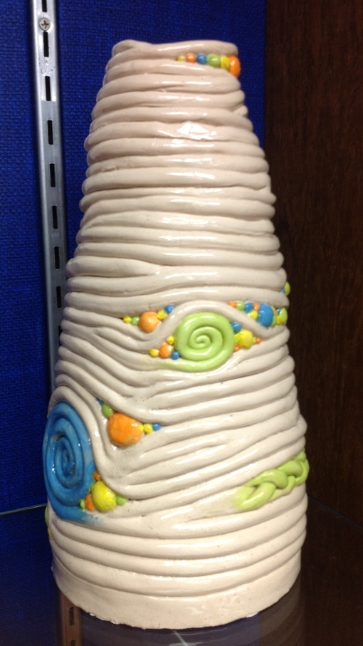
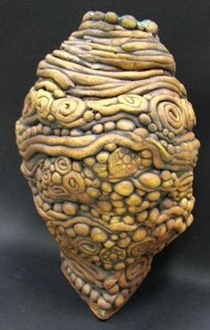
Thoughts on the shapes?

Slide 9
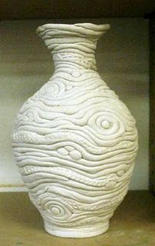
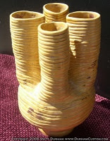
Thoughts on these forms?

Slide 10
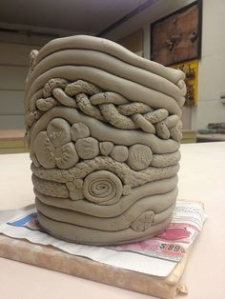
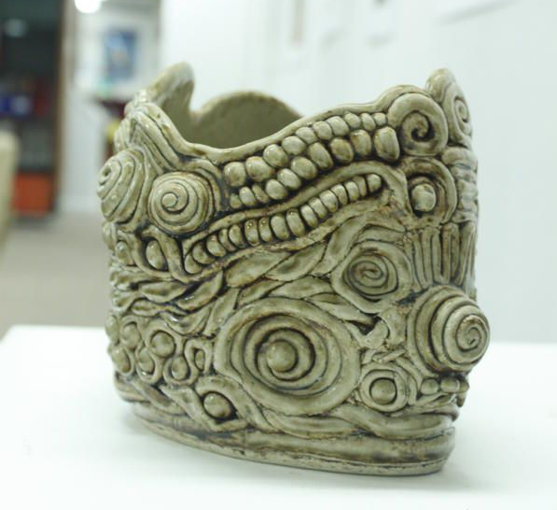
Thoughts on these styles?

Slide 11
Things to consider…
Make sure the shape will be able to stand on it’s own
What is the purpose of your vessel? If it’s to hold water, make sure there aren’t any holes in your piece.
What will the opening look like?
What style will your coil vessel be? Organic? Geometric? Clean lines or free-flowing lines?

Slide 12
Due Date
Your coil vessel should be created and ready to start drying by the end of class on:
A days: October 4 (5 days)
B days: October 5 (5 days)

Slide 13
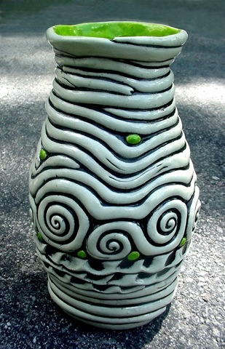
Questions?
Next, a demonstration on how to make your coil vessel

