Slide 1
Color Wheel/Color Theory
Art 1

Slide 2
Before we begin…
This project is very straightforward, but there are a lot of details and directions. There will be a lot of new terminology and techniques explained.
This is also a very time-consuming project. It will take at least three weeks, so the project is worth 150 points.
This information will directly relate to what we will do for the rest of the year, and what you will do if you go on in art.

Slide 3
The Color Wheel

Slide 4
The color wheel is a diagram used to show us how to mix colors. There are 12 colors on the color wheel. They go in order based on what colors are mixed together to make other colors.
We begin with the three primary colors: red, yellow and blue. These are called the primary colors because “primary” means “first.” You have to start with these colors to mix the others on the color wheel. The primary colors cannot be mixed any other way.

Slide 5
From the Primary colors…
We can use the primary colors to mix the secondary colors (orange, green and violet).
Yellow mixed with red makes orange.
Yellow mixed with blue makes green.
Red mixed with blue makes violet.
Tip- keep the amounts almost even when mixing, but use a little more of the lighter color.

Slide 6
We can also use the primary colors to get the intermediate colors by changing the ratio that we use. The intermediate colors are red-violet, red-orange, yellow-orange, yellow-green, blue-green, and blue-violet.
The name of the intermediate colors comes from the two colors mixed together to create them (the rule is that the primary color comes FIRST in the name.) We need to call the intermediate colors by their proper name. We don’t call them “teal,” “lime,” “maroon,” or things like that.
Remember, you typically need more of the lighter color when mixing. Keep this in mind with your color ratio’s when mixing.
The next slide will show you how to mix the intermediate colors.

Slide 7
Intermediate colors (mixing)
red-violet- red + violet (same as red with a little blue)
red-orange- red + orange (same as red with yellow)
yellow-orange- yellow + orange (same as yellow with a little red)
yellow-green- yellow + green (same as yellow with a little blue)
blue-green- blue + green (same as blue with yellow)
blue-violet- blue + violet (same as blue with red)

Slide 8
That’s why the 12 colors go in the order they do!

Slide 9
Color Values
Remember that “value” refers to how dark or how light a color is.
Be mixing white OR black with a color, you can create different values of that color.
A color mixed with white is called a tint.
A color mixed with black is called a shade.
You can create many different tints by adding more white to a color; you can create many different shades by adding more black to a color.

Slide 11
Tints, Hue and Shades

Slide 12
Other Information
A color mixed with black AND white (“gray”) is called a tone.
We will not be adding black AND white at the same time to a color in this project. In other words you will not “gray” your colors.
When you mix all three primary colors together, you get what is called a “neutral.”
We won’t be using tones or neutrals for this project, but they will certainly come into play later in this unit when we are trying to mix colors we see in real life. Tones and neutrals are often very natural-looking.

Slide 13
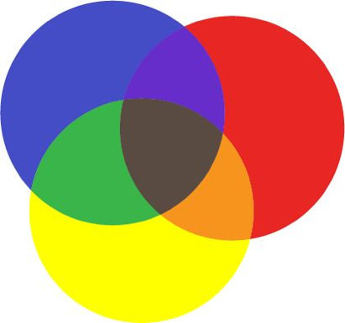

Slide 14
Your project assignment

Slide 15
You will…
You will create a color wheel that has a repeated pattern in each of the 12 wedges/slices (“radial design”)
Each wedge will include the hue, and anywhere from 4 to 5 different tints and 4 to 5 different shades.
You will only have red, yellow, blue, black and white paint.

Slide 16
Trace the wheel. Make notches to separate the wedges. Make sure all pencil lines are drawn lightly

Slide 17
Use a ruler to draw the lines to separate the wedges.

Slide 18
It should look like this.

Slide 19
Draw out your design on the template using a wooden pencil. Use 10-12 shapes. Don’t make them too small. Once approved, go over in thin sharpie

Slide 20
Go over to a light table and trace wedge into all 12 slices

Slide 21
Keep repeating this step for all 12 wedges.

Slide 22
Done!

Slide 23
Label the colors in order.

Slide 24
Number the shapes on your template. Scatter the numbers. Keep this! You’ll need to use it as a guide.

Slide 25
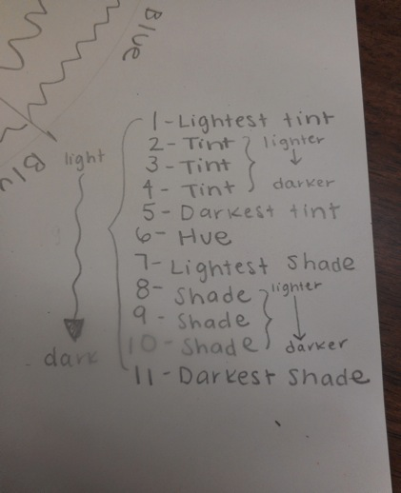
Make a key for yourself. 1 will be the lightest and your highest number will be the darkest. Remember to have one shape be the hue.

Slide 26
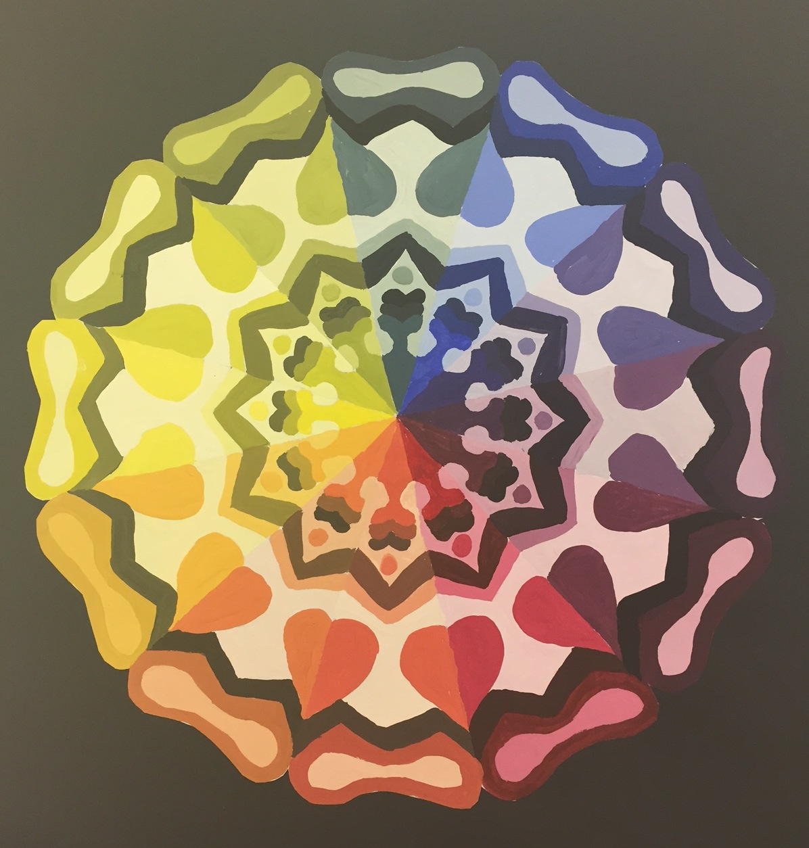

Slide 27
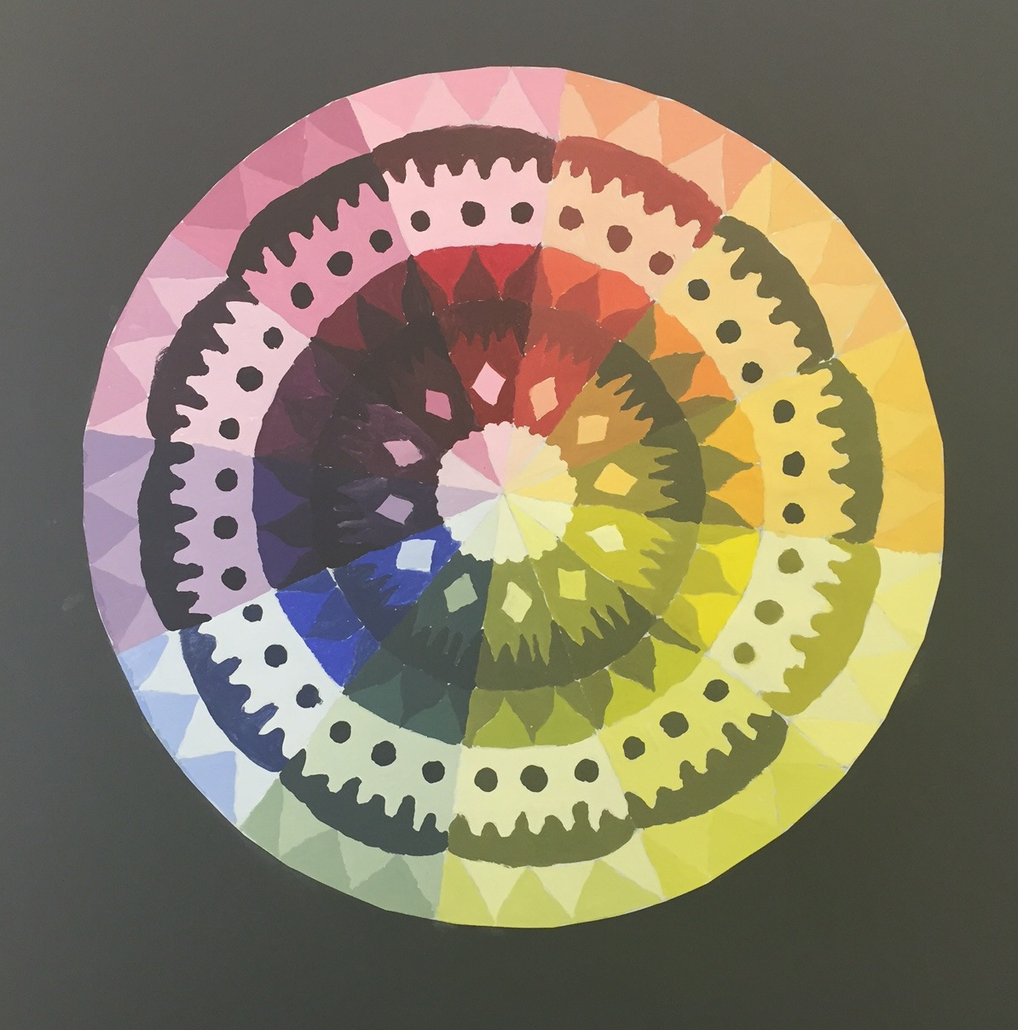

Slide 28
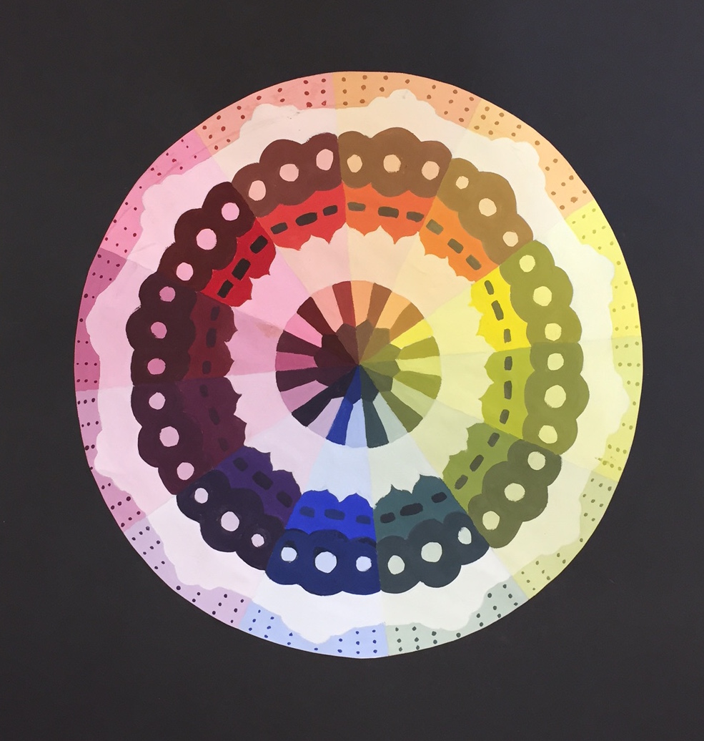

Slide 29
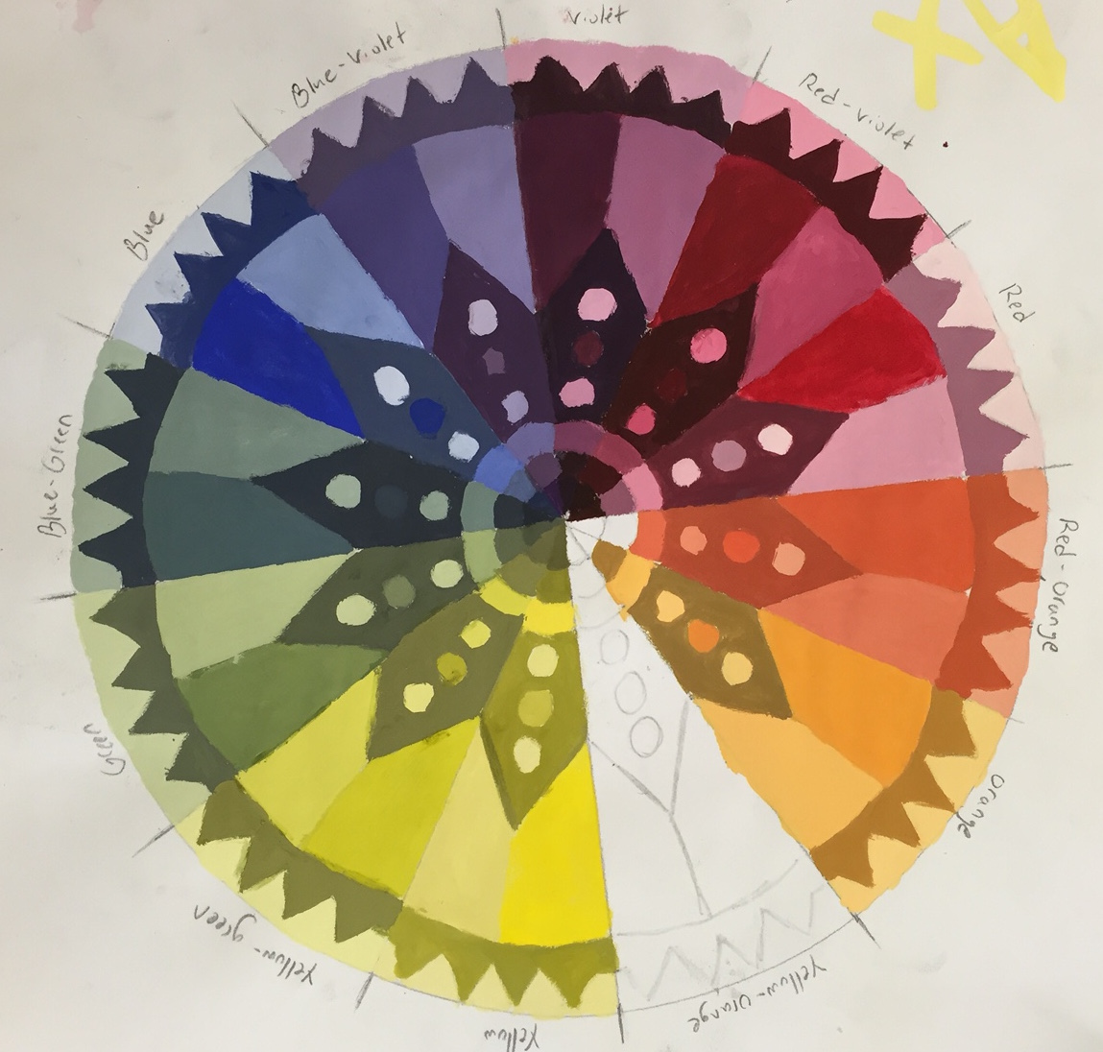

Slide 30
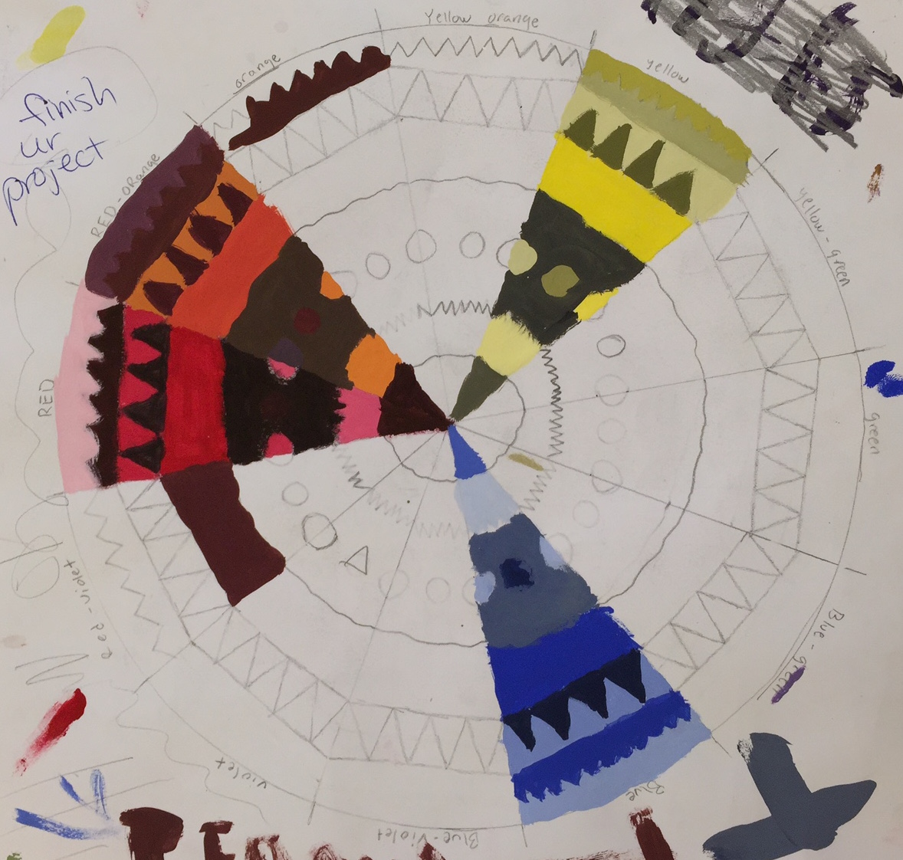

Slide 31
Time to paint! Start with a primary wedge. Get out only the colors you need. Also get out two brushes (thick and thin), a water cup, and a paper towel.

Slide 32
You need less paint than you think!

Slide 33
Start with the hue first because its already mixed for you (I decided my hue is going to be in shape #6, which happens to be right in the middle of the wheel)

Slide 34
When you mix your tints ADD THE COLOR INTO THE WHITE. Add a tiny bit of color at a time as you mix each different tint.

Slide 35
Mix it up…not mixed well enough yet!

Slide 36
That’s better! This will be my lightest blue tint. I have to paint this in my #1 shape.

Slide 37
See why the template and the key are important? If I didn’t have them, I would get really confused!

Slide 38
Time to mix the next tint. I’m adding a little more blue and mixing it right in.

Slide 39
Make sure you can tell the tints apart, and your shapes aren’t blending in to one big shape. You can always let the tempera dry and paint over it if you really need to.

Slide 40
Keep adding a little more blue and painting in each of the different tints into the corresponding shape. My tints are done!

Slide 41
Time to mix the shades! DO NOT gray your colors by having the white get in the shades! Mix the shades separately on your palette.

Slide 42
Don’t forget to rinse your brush…

Slide 43
…and dry it off.

Slide 44
Add the black a tiny bit at a time. WHEN YOU ARE MIXING SHADES, MIX THE BLACK INTO THE COLOR.

Slide 45
Here is my first shade.

Slide 46
I found the number and painted it in that shape.

Slide 47
Keep going, adding a little more black and painting in the different shades you create in the shape they belong in. My first wedge is now complete! Only 11 more to go…

Slide 48
Work in this order:
Primary wedges first
Then secondary wedges
Then intermediate wedges
Try to finish about one to two wedges per class.
If you mix a color, try to finish that wedge during that class period. Otherwise, you will have to re-mix the color next time.

Slide 49
When you’re doing the secondary and intermediate wedges…

Slide 50
…mix up the color completely FIRST. Mix up two “piles” so you can do your tints with one and your shades with the other.
This times two!

Slide 51
Time to clean up! Rinse the palette in the sink.

Slide 52
Use a sponge and toothbrush…

Slide 53
…until the palette is clean…

Slide 54
…then rinse the sponge and wring it out.

Slide 55
Rinse the brushes with soap until the water runs clear.

Slide 56
Wash any and all globs of paint down the drain.

Slide 57
Rinse your cup.

Slide 58
Brushes should be UP!

Slide 59
Stack the cups nice and neatly!

Slide 60
Other stuff…
Don’t forget to wipe the table tops.
Put the paint back where it belongs.
You will store your work in your shelf.
Tempera takes about ten minutes to dry completely.
Tempera lightens a little as it dries, so your colors may change slightly.

Slide 61
Due Date Information
You will have 13 classes to complete this project.
Your work is due with your rubric on Feb 2nd 3B or Feb 5 2A
Take your time with your work. These will come out great if you know what you’re doing and work hard. Anyone can make a great color wheel if they put the effort in.
If you are behind, get caught up along the way instead of at the end (you will get overwhelmed; I cannot allow paint to go home).

