Slide 1
Elements of Art and Principles of Design Prisms
Art 2

Slide 2
You Will…
We will review the Elements of Art and Principles of Design (review from Art 1).
You will then apply your knowledge of these concepts by creating two 3D eight-sided prism (following a template). Each side will demonstrate a different element/principle (one prism will show the elements, the other will show the principles).
The subject matter of each side of the prisms will have a single, cohesive theme.
We’ll learn the elements first, then the principles.

Slide 3
Elements of Art
There are SEVEN Elements of Design. They are:
Line, Shape, Color, Texture, Value, Form, Space
The way the Elements are set up in a piece of art work end up creating the PRINCIPLES.
There are SEVEN Principles of Design. They are:
Balance, Contrast, Emphasis, Movement, Harmony, Rhythm, Unity, Variety
The Elements and Principles of Design help us describe any piece of art from our own, our peers, famous pieces etc. They can be used on any type of art from 2D to 3D, to graphics, fashion etc. The Elements and Principles are the universal language with which we can discuss how a piece of art “works” visually. We want to try to use this language as much as possible when we talk and write about art.
Note that you may hear the specific list of Elements and Principles referred to slightly differently than we do in this class (sometimes there are a few more added, but these are the ones we’ll use in here).

Slide 4
Element of LINE
A line is a point that moves.
Lines have type, weight and direction.
Type- The line’s description (curvy, zig-zag, straight etc.)
Weight- How thick or thin a line is (thicker=heavier)
Direction- How the line makes the viewer’s eye move
Lines can be actual or implied.
Actual- A solid, unbroken line
Implied- A broken line that the eye still follows

Slide 5
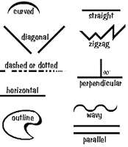
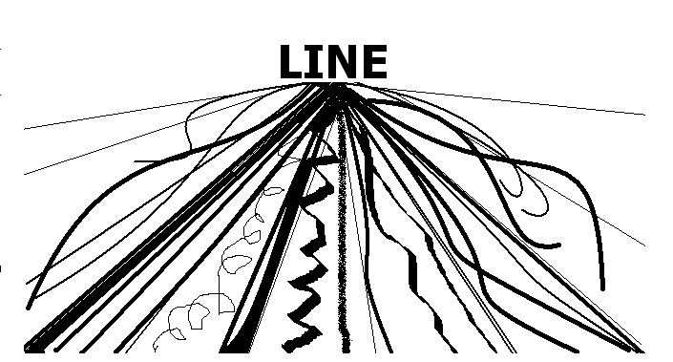
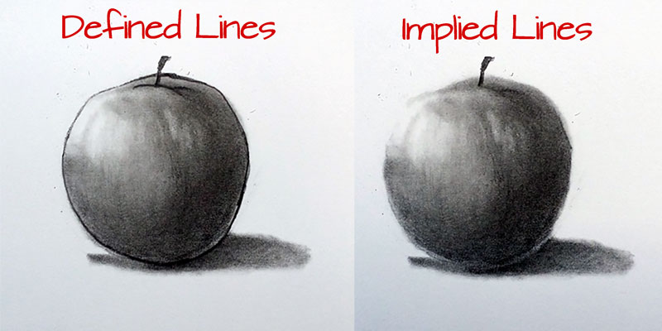
Different line weights in a drawing
Line Types
Line direction

Slide 6
Element of SHAPE
A shape is a closed up line.
There are two basic types of shapes, organic and geometric.
Organic Shapes- Non-precise shapes
Geometric Shapes- Shapes with precise, measurable edges and angles

Slide 7
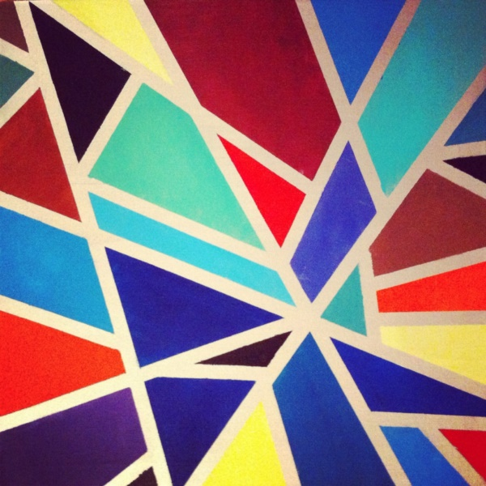
Geometric Shapes
Organic Shapes

Slide 8
Element of COLOR
Color can be described using the properties of hue, intensity, and value.
Hue- What the color is named (“red,” “violet,” “blue-green” etc.)
Intensity- How vivid or saturated the color is
Value- How light or dark the color is

Slide 9
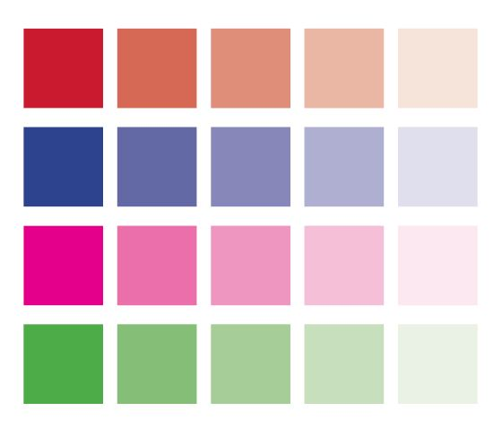
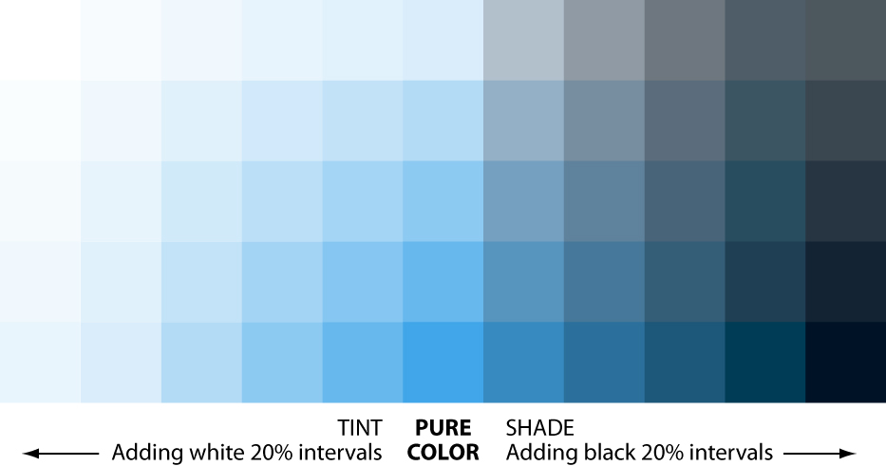
12 hues of the color wheel
Four hues, each with five different levels of intensity
Color values (tints, shades and tones) of one hue (blue)

Slide 10
Element of TEXTURE
Texture is a tactile feeling
Textures can be actual or implied.
Actual Texture- Texture that you can actually reach out and feel (usually in a 3D piece)
Implied Texture- The perception of texture (usually in a 2D piece)

Slide 11
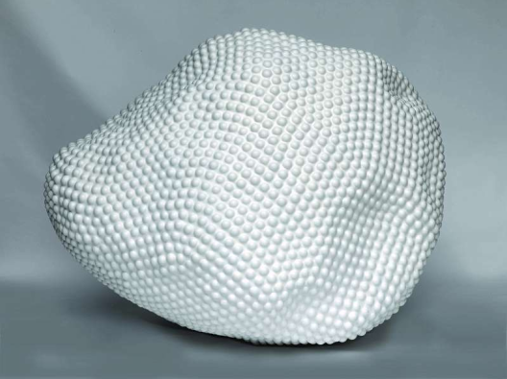
Actual texture in a sculpture (bumpy)
Implied texture in a drawing

Slide 12
Element of VALUE
Value is how dark or how light something appears.
Value can have contrast and tonality.
Contrast- The degree of change between values (high contrast or low contrast)
Gradation- The seamless, gradual change between values

Slide 13
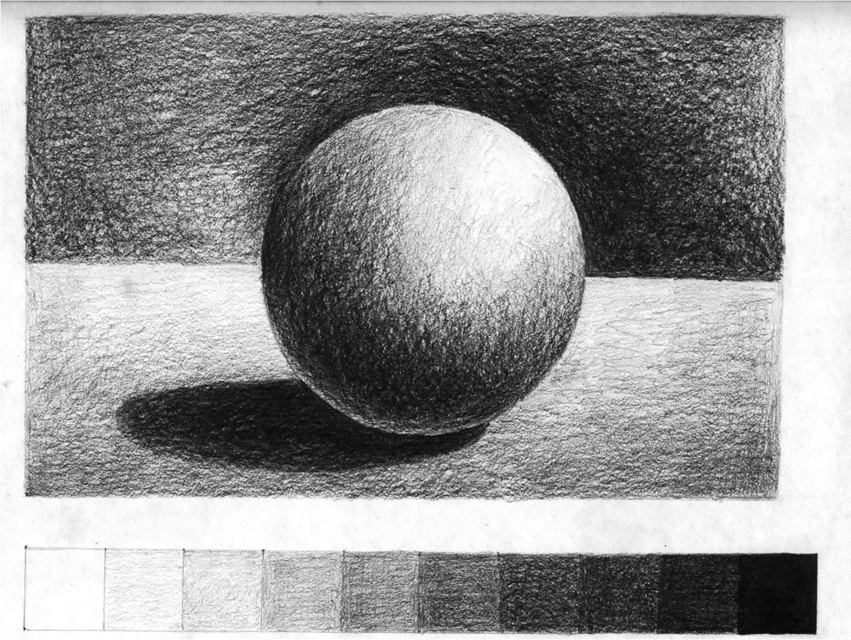
A drawing with ten distinct values and high contrast (white to black)
A drawing this distinct value and contrast, but also gradation

Slide 14
Element of FORM
Form is how three dimensional something is, or how three dimensional it appears.
Three dimensional artwork has literal form (a sculpture takes up space).
Using drawing/painting techniques such as perspective and shading, we can create the illusion of form in a two-dimensional artwork.

Slide 15
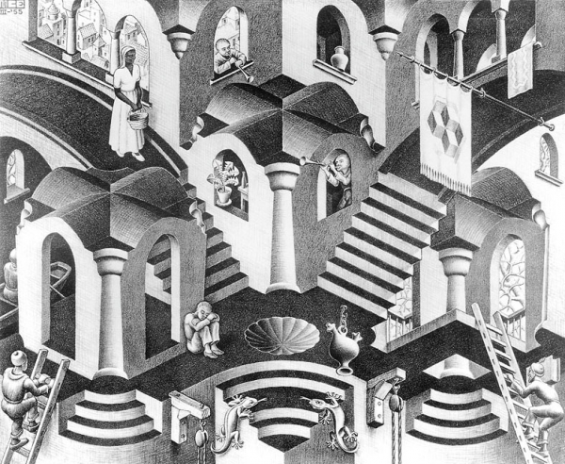
This sculpture has actual three-dimensional form.
This two-dimensional drawing creates the illusion of form through shading and perspective.

Slide 16
Element of SPACE
Space is a sense of depth in an artwork.
We use the terms foreground, middle-ground and background to refer to areas of the picture plane.
Picture plane- The area that a viewer can see in a 2D work of art.
Foreground- The part that is closest to the viewer.
Background- The part that is furthest from the viewer.
Middle-ground- The part that is between the foreground and background.

Slide 17
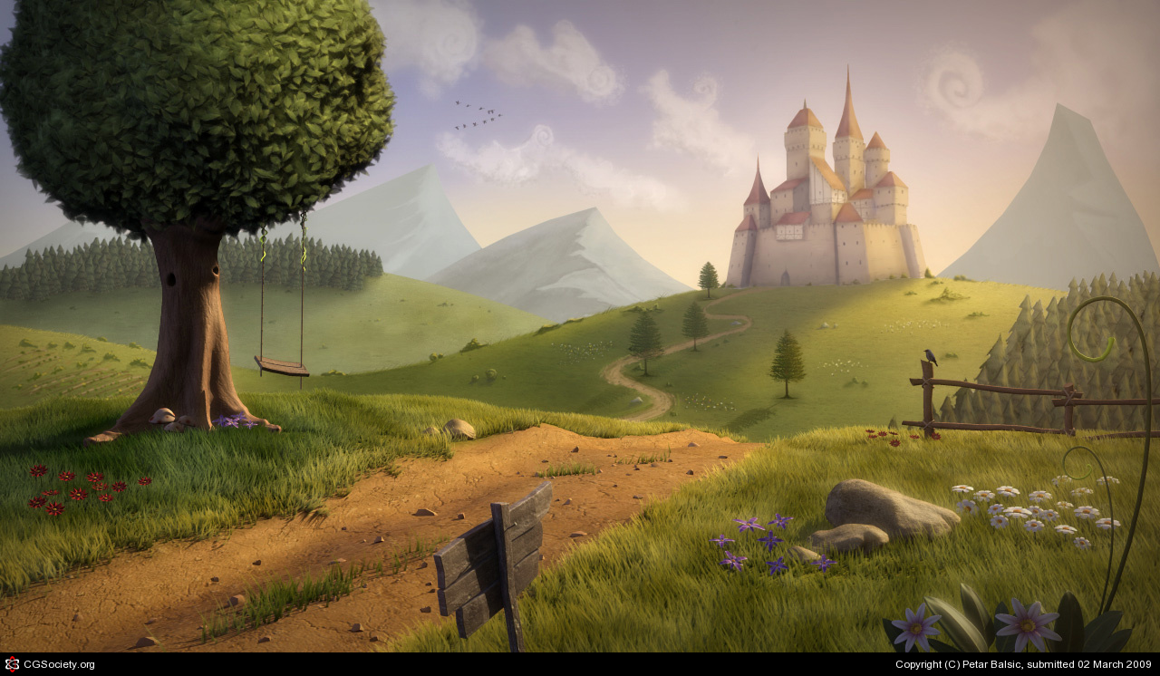
An illustration of the picture plane (how much the viewer is being shown of the scene)
Background
Middle-ground
Foreground

Slide 18
Procedure
Step by steps will be handed out. These should be stapled into the 2nd section of your sketchbook.
I should not be asked questions like “what do I do next?”…look at the steps I’m giving you. I’m here to guide you, not to tell you exactly what to do.
Problem solve and observe what your peers are doing.

Slide 19
Timeline
Day one- Intro; cut templates and plan
Days 3, 4, 5, 6- working on the sides of the prism (if you finish one and a half sides per class, you’ll be on track)
Day 7- wrap up; assembly of prisms
Due date: Sept 27th

