Slide 1
Face Mugs
Ceramics 1

Slide 2
Spin off of Face Jugs
The creation of clay face jugs is a long North Carolina tradition dating back to the 1820’s
In the 1830’s about 70 folk potters operated pottery shops within a four mile area of Mossy Creek in White County, Georgia.
The purpose of the jug evolved. The face jug also became known as the ugly jug in the 1920's and was used to store alcohol. The jugs became uglier in an attempt to identify the contents and frighten children. Parents warned the youngsters to stay away from them.

Slide 3
What is function?
Function is when something has a purpose and successfully fulfills that purpose.
An example would be that a mug’s purpose is to be filled with liquid to drink out of.
Your mug is intended to be functional! In order to receive a good grade and create a great face mug, your mug must function as an object to hold liquid and/or food.
All edges, especially the lip and handle, must be smooth to the touch so someone using the mug will not cut their lips or hands.

Slide 4
What is a mug?
In our case, a mug is a cylindrical object that holds liquid and/or food.
Always, a mug must have a handle in order to be a mug!!
Without a handle, it’s not a mug therefore you did not create the project assigned.
Handles can be made 1 of two ways:
Slab: Cutting out a thick slab and shape it to the desired size and shape of the handle
Coil: Rolling out a coil to the desired size and shape of the handle

Slide 5
More to think about when creating handles…
The handle must be strong enough to hold the weight of the mug
Make sure to attach the mug with scratch and slip method as well as putting coils around the attachment for support!
Who is the mug for?
Will the handle fit that person’s hand?
How many fingers do you want to fit inside of the handle?
Men tend to use 1-2 fingers when holding a mug
Women tend to cradle or to use their entire hand or more fingers when holding a mug

Slide 6
3D Aspects…
Make the face of your mug as 3D as possible as long as it’s functional!
DO NOT have anything on or near the lip of the mug! It will get in the way of drinking from it, therefore it not being functional!!
Be creative! Please do not just choose a smiley face and be done with it…
The face must be human-like. Realistic, exaggerated. NO animals!

Slide 7
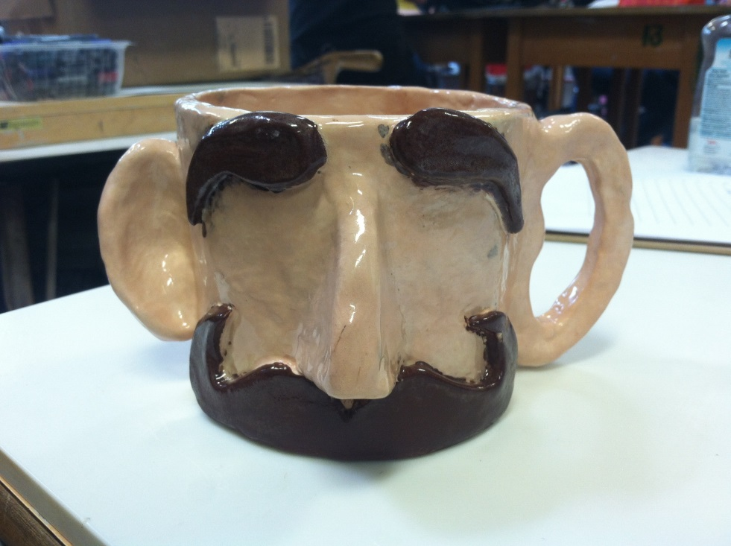
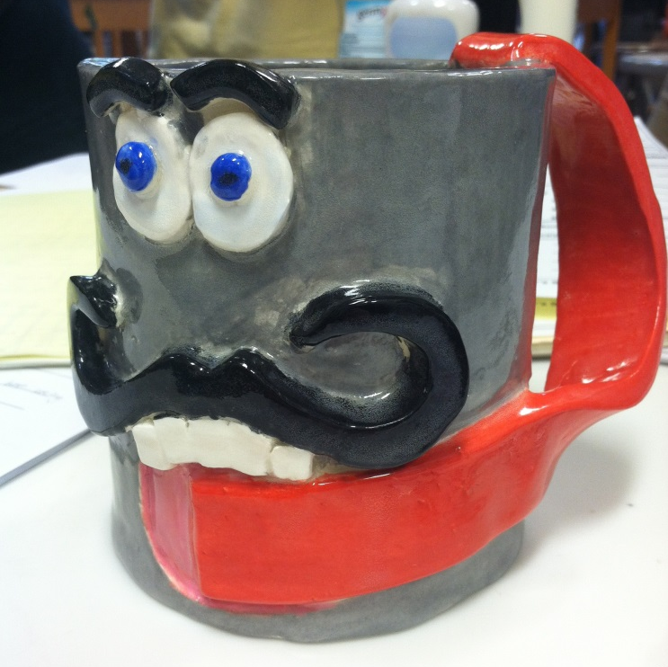
Examples of student work…

Slide 8
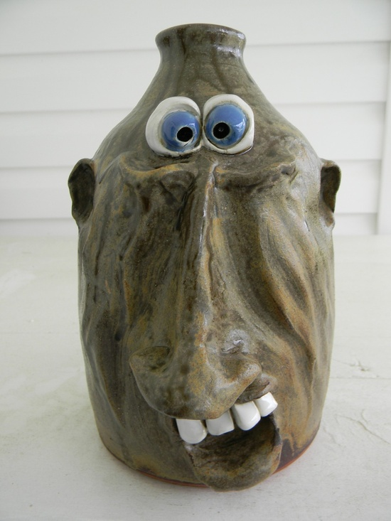
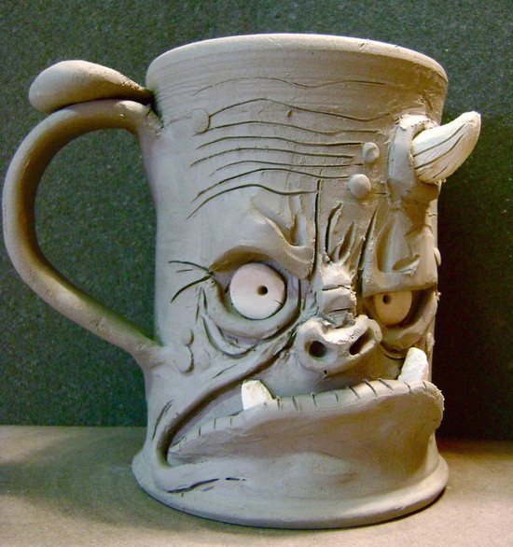
Face Mugs/Jugs

Slide 9
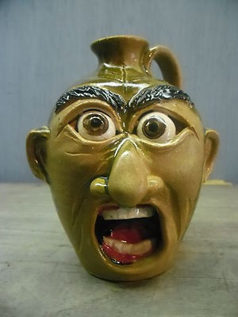
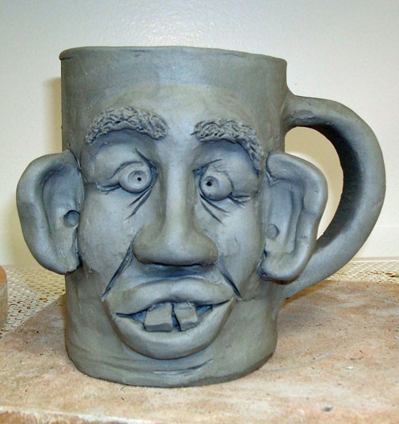
Continued…

Slide 10
Size Requirement
4 Inches
4 inches wide
5-6 inches tall
5-6
Inches

Slide 11
Step by Step Instructions
You will receive a separate sheet of paper with step by step instructions. Please make sure to go over it carefully!

Slide 12
Questions?
Mugs need to be completed by the end of class on
A days: Nov 7th
B days: Nov 9

