Slide 1
Glazing
Pottery 1

Slide 2
Disclaimer….
How well an artist glazes a piece of work will either enhance and make the work better, or it will make the artwork look worse.
Glazing is extremely important and even though it may look easy or the concept of glazing is easy, it does takes practice, concentration, and experience. You spent the time to make your project so spending a good amount of time finishing it is just as important.
What you want your project to look like and how it actually comes out of the kiln can be different. The beauty of ceramics is how the clay, glaze, and overall process has a little bit of a mind of it’s own and we learn to appreciate those imperfections and surprises.

Slide 3
Glaze
Glaze is a coating of powdered ceramic materials usually prepared and applied in water-suspension, which melts and bonds to clay surface in glaze firing

Slide 4
Absorbency
Bisqueware is extremely absorbent.
If you paint glaze on an area where you didn’t want that color, the clay absorbs it immediately and wiping it away with a sponge will not fix the problem.
You need to be very careful when you glaze to ensure your applying the right glazes/colors to the desired area.
Bisqueware can also absorb dust which will clog the pores of the clay. If this happens, the glaze will not effectively be absorbed and there could be spots on your piece with less or no glaze after
It’s really important your shelf is clean, your hands are clean and the tables are clay dust free when you glaze to ensure the only thing your project is absorbing is glaze.

Slide 5
Brushes
There are specific glaze brushes we use. They are designed for glaze…Make sure the container says “GLAZE”
Please make sure you’re using a SMALL brush for SMALL areas. LARGE brushes for LARGE areas. Don’t be lazy!
If a LARGE brush is used for a SMALL area, you won’t be able to keep the glaze just on that small area. The glazing will look messy.
If a SMALL brush is used on a LARGE area, you will be applying the glaze in streaks and you’ll see the inconsistency after the glaze fire.
All brushes must be washed just with water (no soap!) after being used. Brushes go UPRIGHT back in the designated containers.

Slide 6
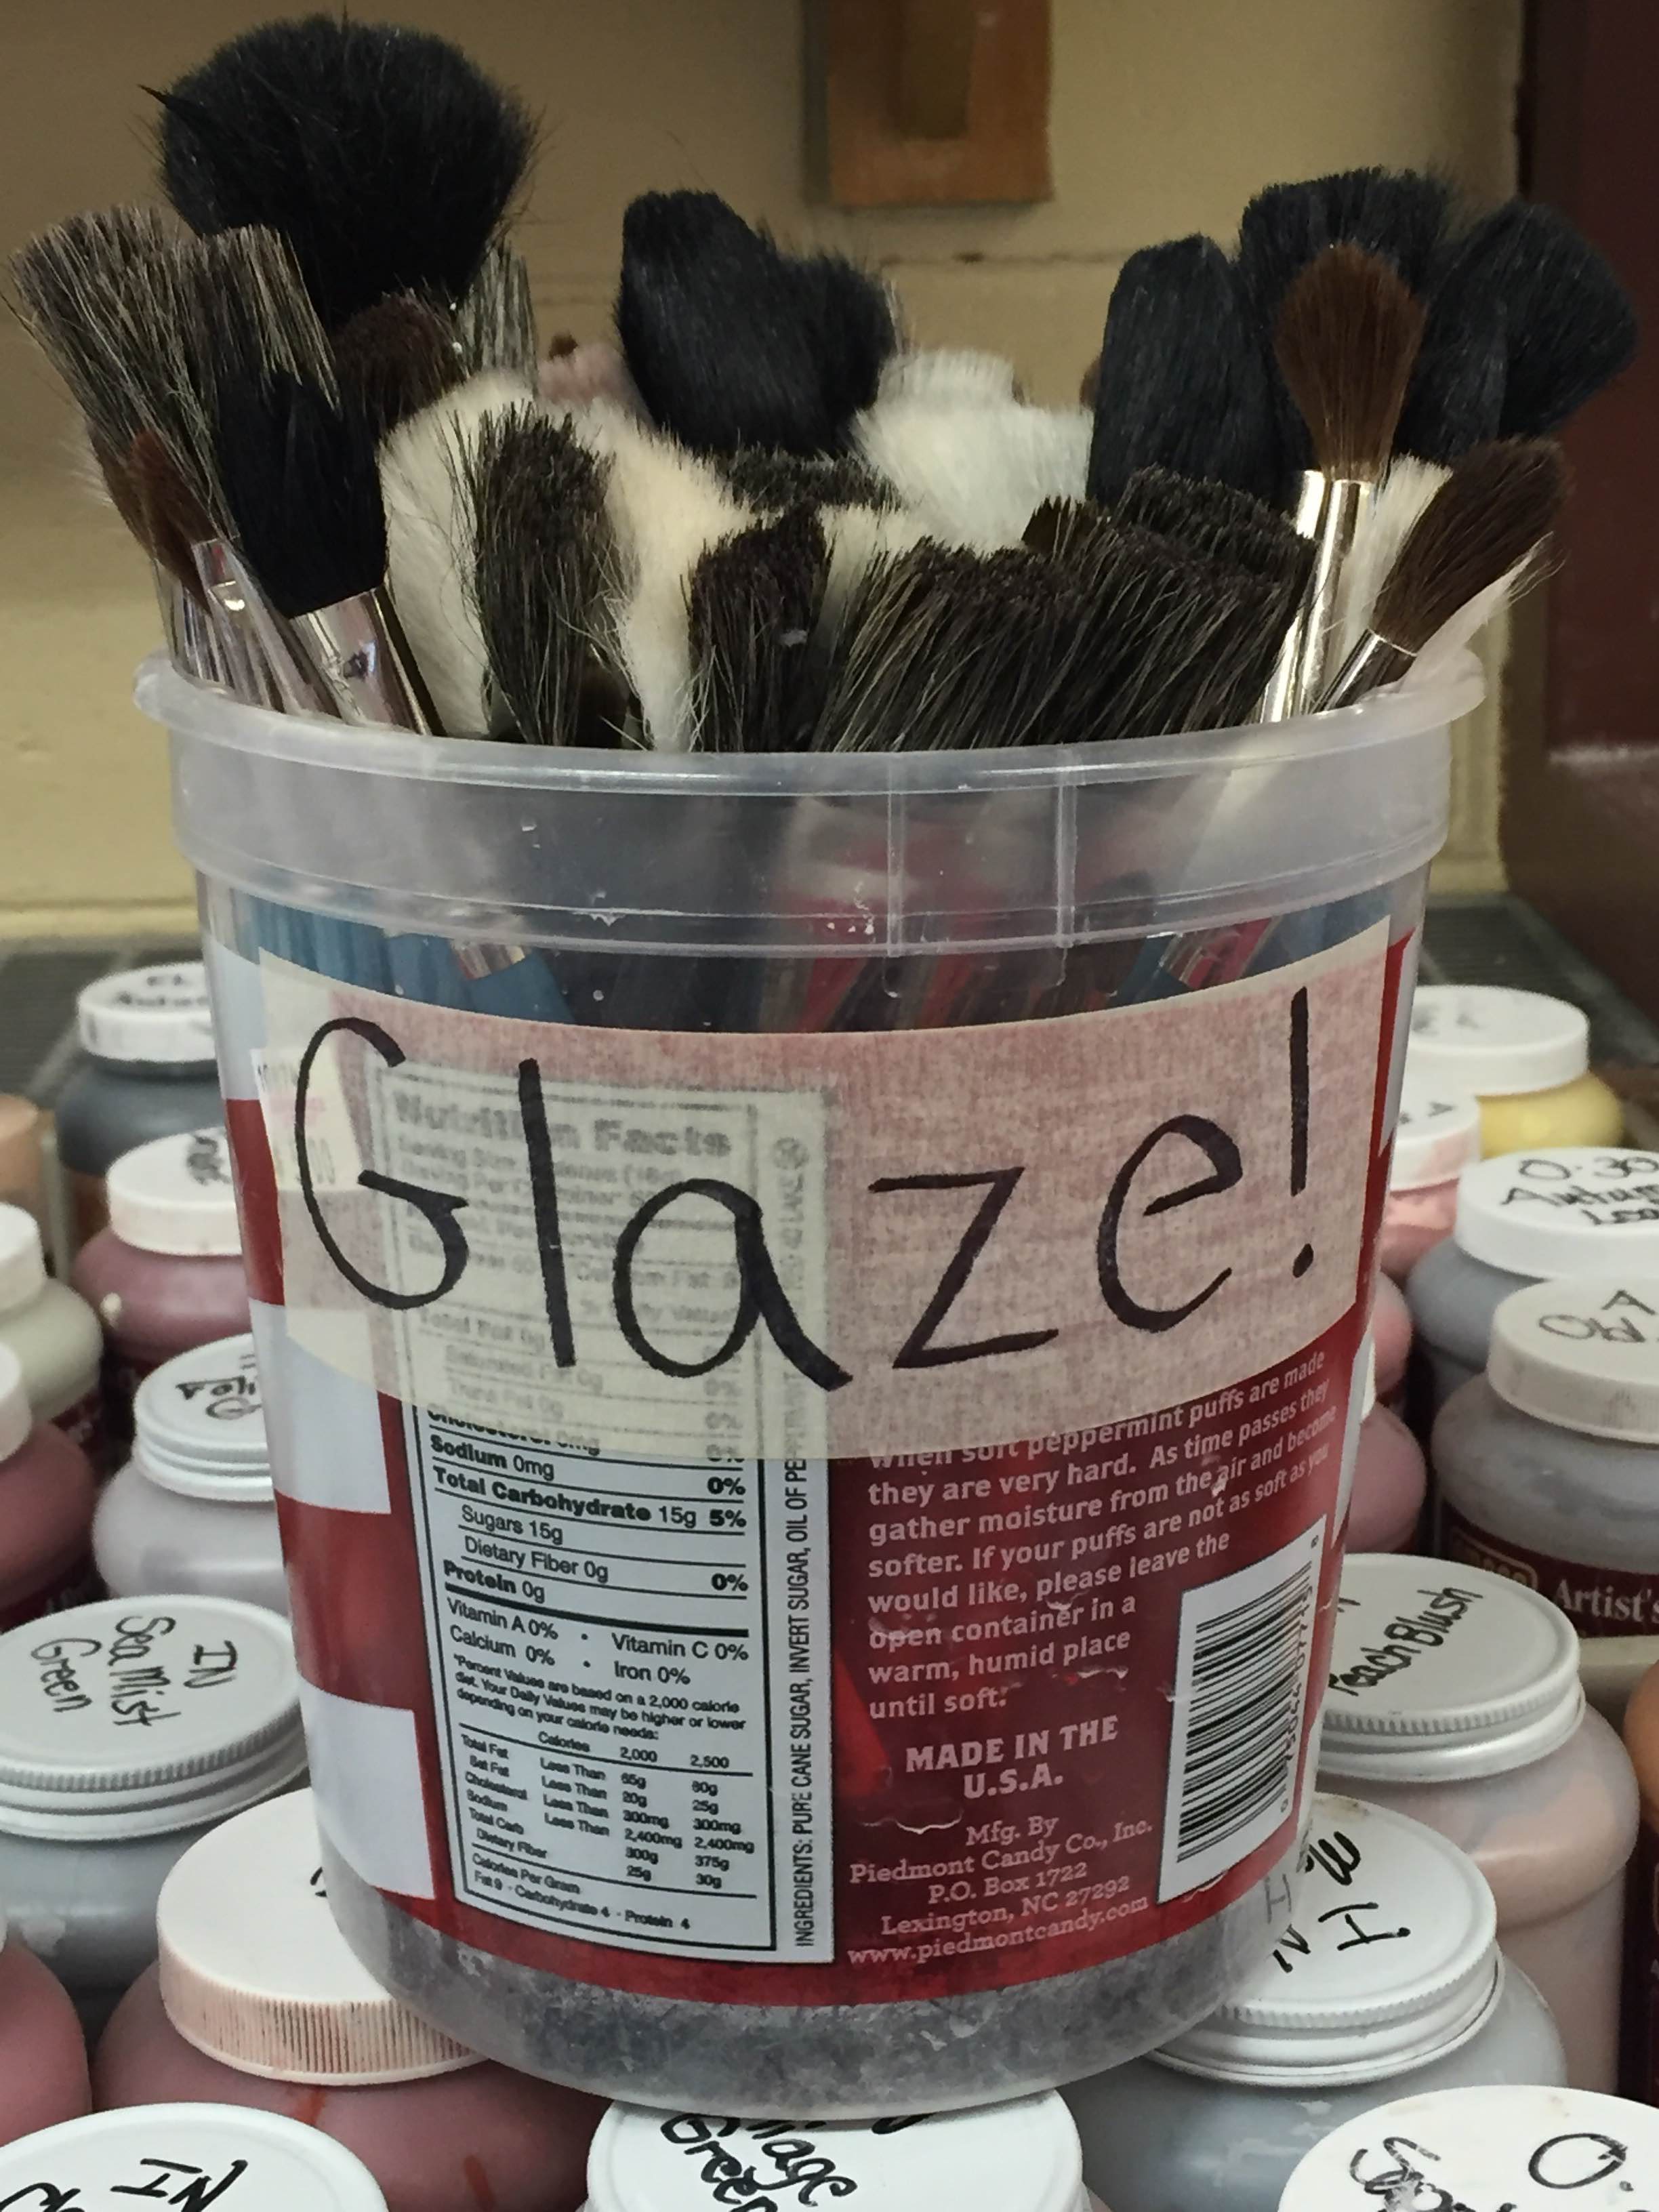
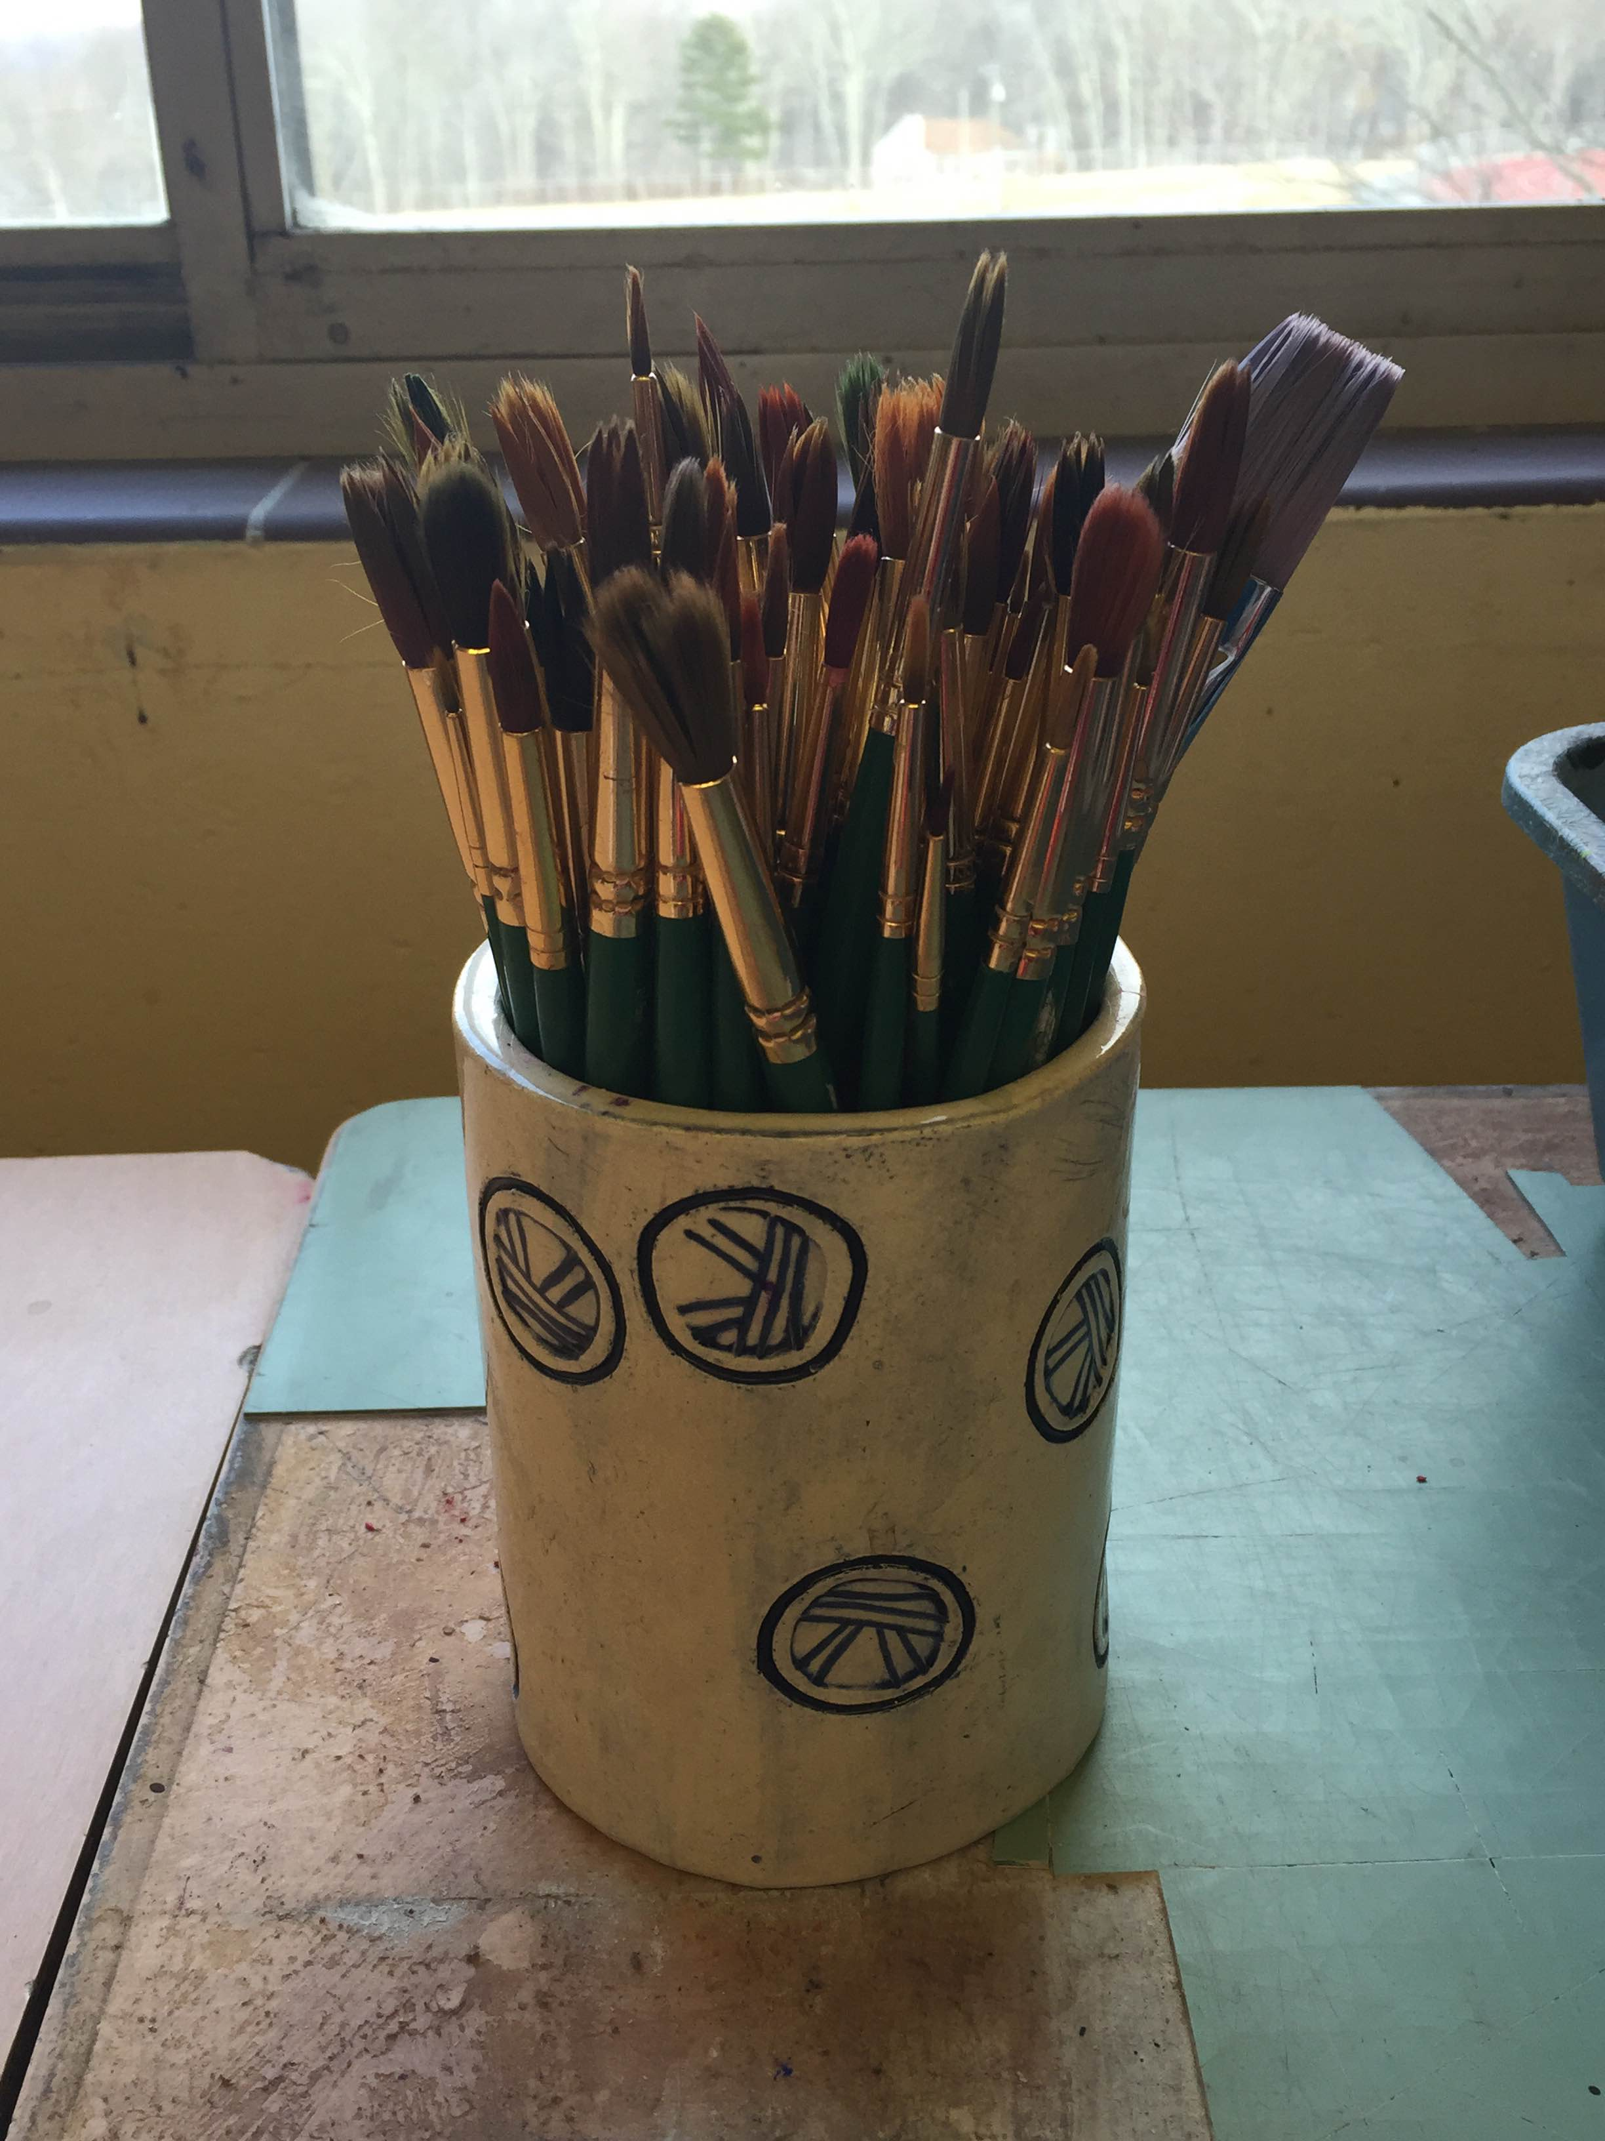

Slide 7
Glaze
Before the glaze is fired, it looks like a completely different color. In the kiln, the glaze turns to the color we expect it to.
It’s important to look at the test tile to figure out what the glaze will look like. You cannot determine the color based on what it looks like in the bottle! Trust the test tile!
Glazes like to thicken up over time so it’s important to SHAKE the bottle. Make sure the lid is securely on before shaking over the sink with your hand on top of the lid!
If the consistency is thick and does drip easily off the brush, water will need to be added and come see me to have this done. Too much water will ruin the glaze.

Slide 8
Glaze Cont.
3 coats should be applied evenly! Pay attention to where you put glaze!
DO NOT apply glaze to the bottom of your pot! Glaze becomes liquid glass in the kiln and it will stick to the shelf-ruining your pot and the kiln furniture.
When you are done glazing, you will take a small yellow sponge and clean the bottom of your project making sure there is no glaze on the bottom! Sliver of bisque all the way around

Slide 9
Different finishes
Glossy: shiny and reflects light after glaze fire; does show the color of clay. It will show/enhance carving details but also imperfections
Matte: dull, non-glossy surface. It is not ideal for functional work. Will hide details! Not recommended to be inside functional ware
Opaque: does not let light shine through or let the color of the clay show through. Make sure to check the test tile before choosing it for a piece with a lot of details (carved hair, small detailed features, etc.)

Slide 10
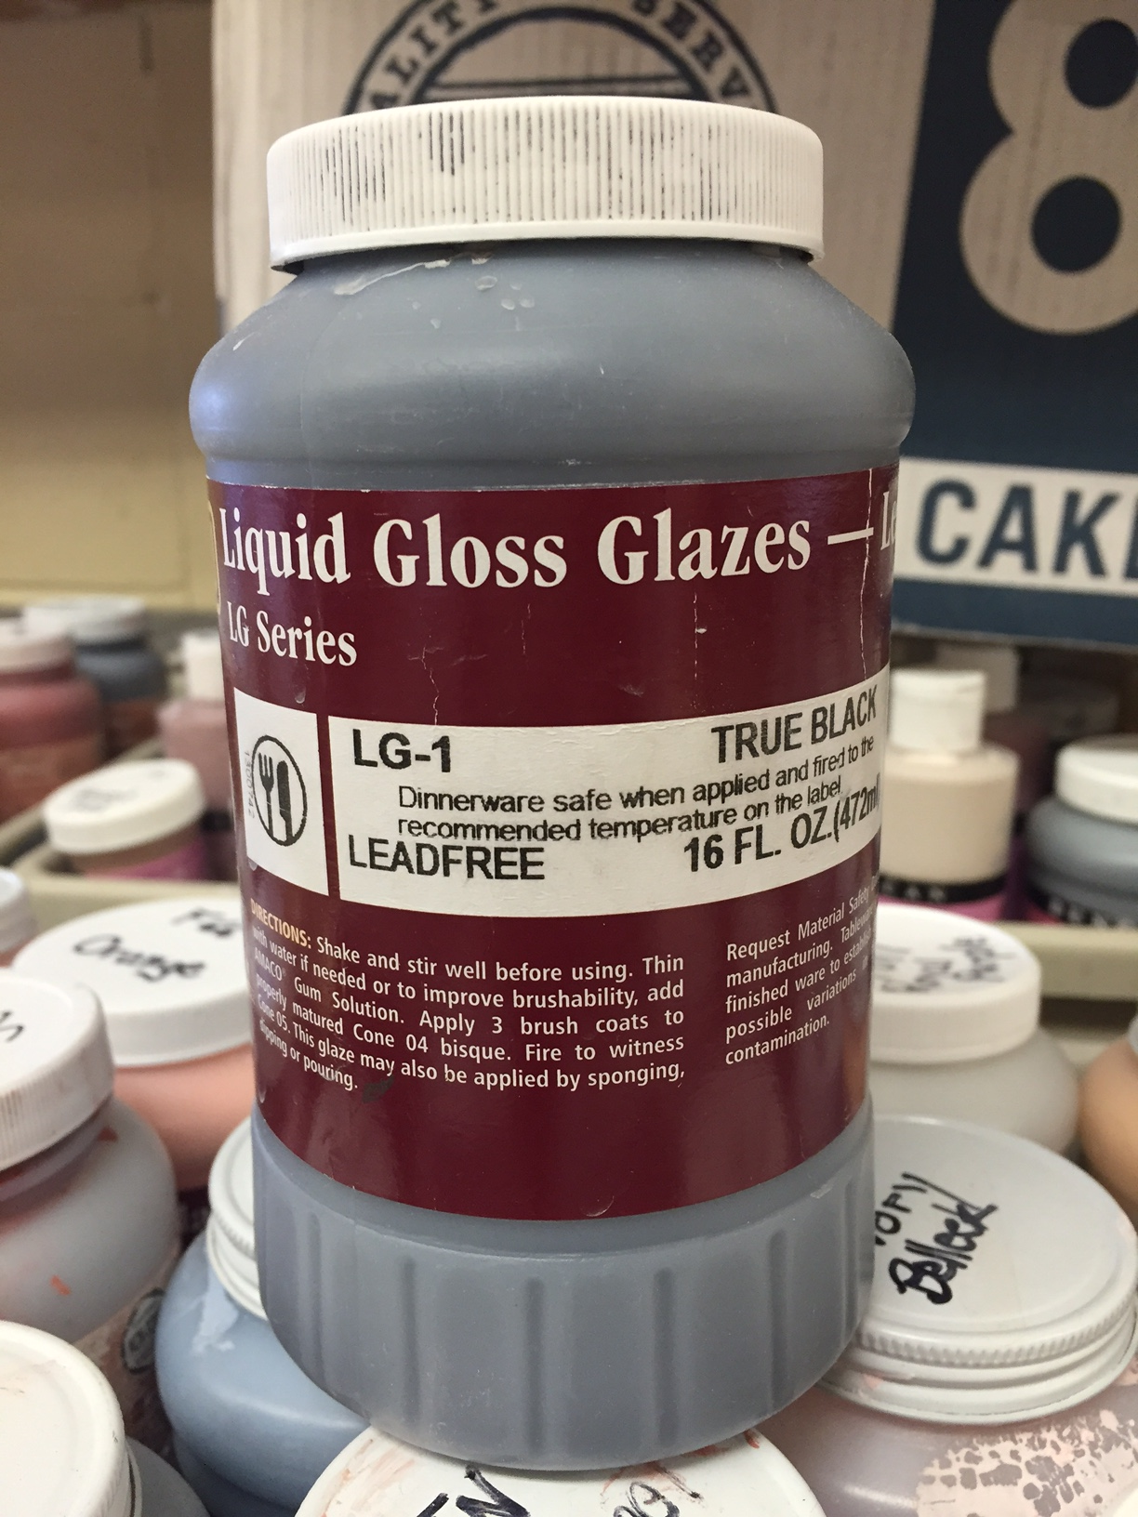
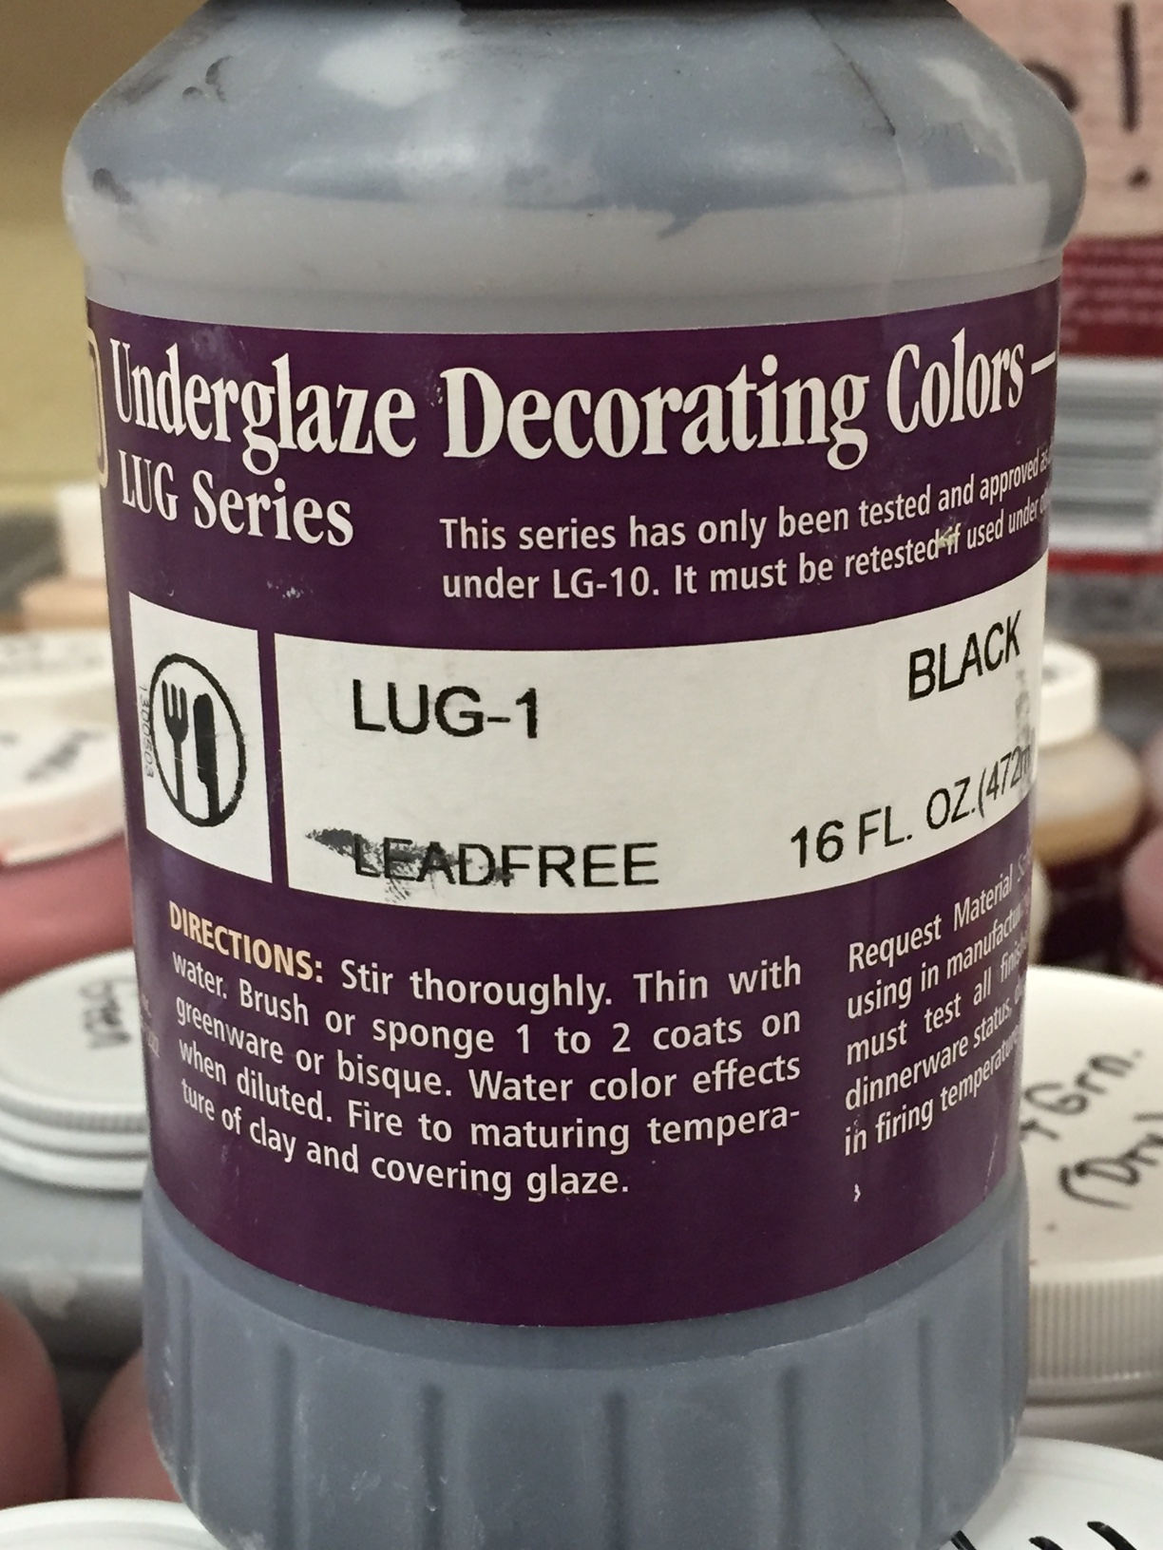

Slide 11
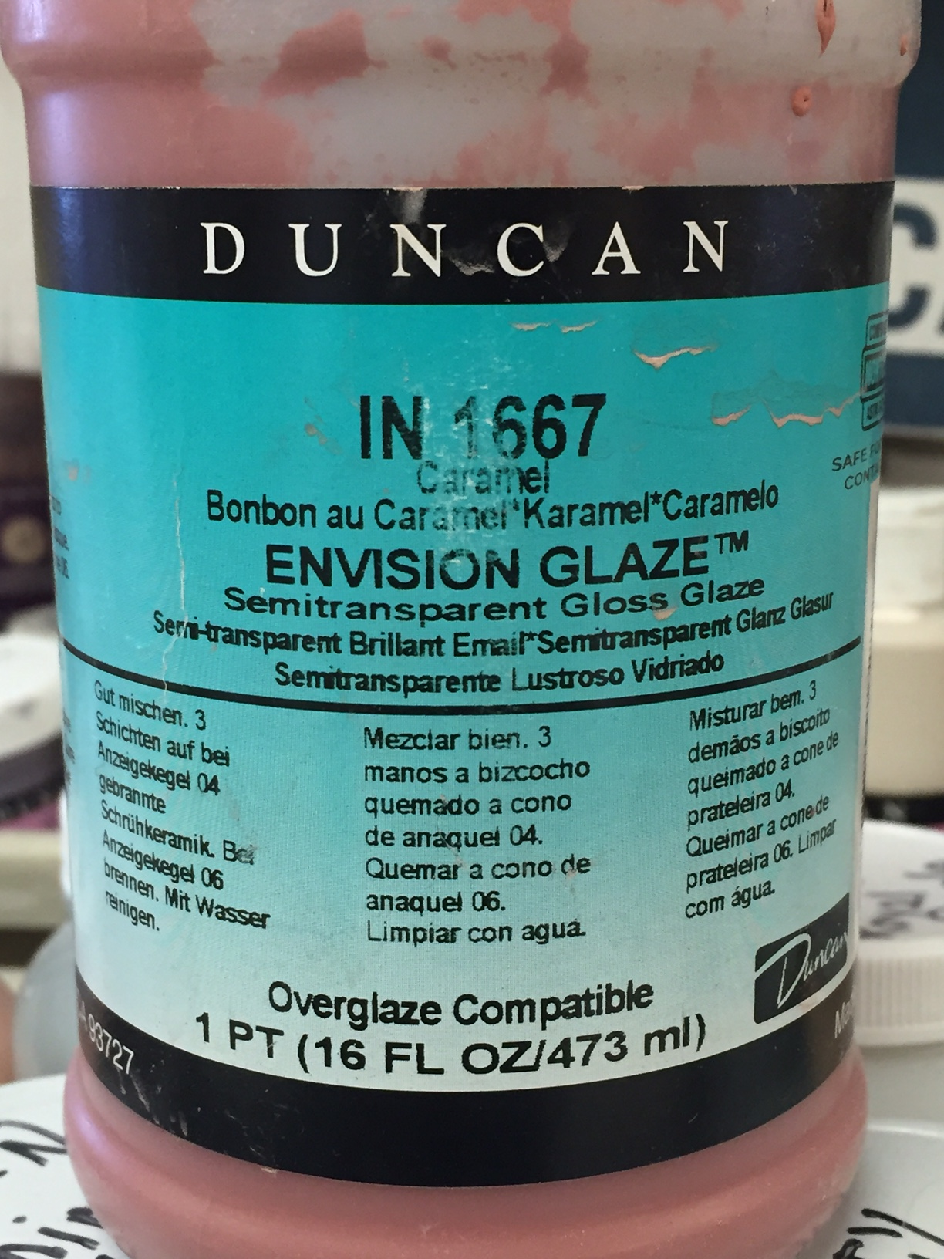
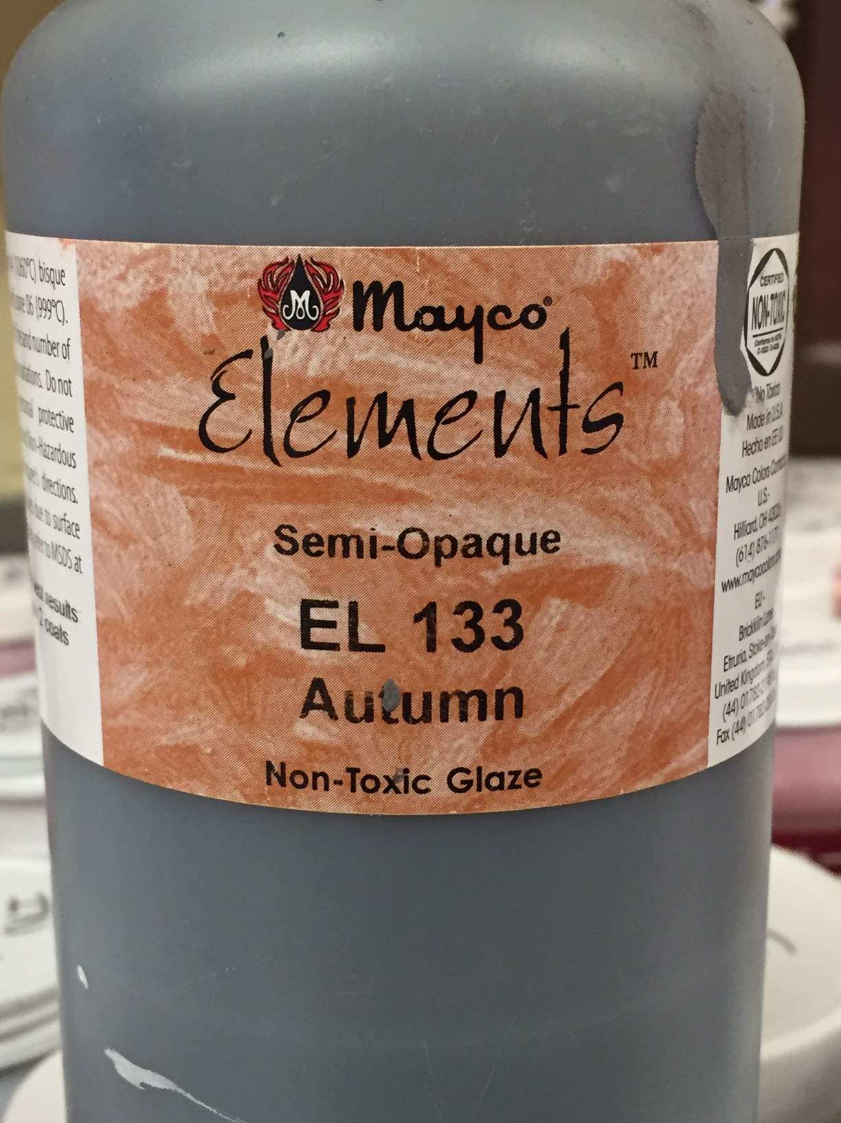

Slide 12
For Bobble Heads
Your head will sit on top of your body in the glaze kiln
So where can you NOT glaze?
Use a pencil to draw a line on the body so you don’t glaze areas where you don’t need glaze. Pencil will burn out in the kiln and not effect your glaze

Slide 13
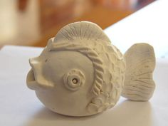
Steps:
In your sketchbook, open to the drawing of your project and plan your glazing. Mark where certain colors are going to go using the actual name (Copper Adventurine, Leaf Green, etc.) Black is only to be used for small details like eyes. Your project will never be all black! It hides details…
Canary Yellow
Dark Blue
Vivid Orange
Emerald Green
If you forget to do this first step, I cannot see what you plan on doing and I cannot help you figure out what glaze you used previously! All glazes look about the same before getting fired.

Slide 14
Steps continued
Make sure there is no dust on your project-wipe clean with your hands if necessary.
Apply 2-3 coats of the glaze.
You cannot contaminate glaze! No dipping the same brush in 2 different bottles without fully cleaning it first.
If you are layering, glaze 2 coats of the under color. CLEAN THE BRUSH. Wait until the 2 coats dry, then glaze 1 coat of the top color.
Wait until project is dry and clean the bottom with a damp, wrung out sponge! Please don’t use paper towels
Get approved by me!
Finished project will be taken and put in the kiln room by myself only.

Slide 15
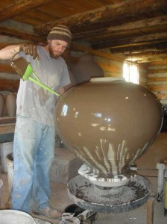
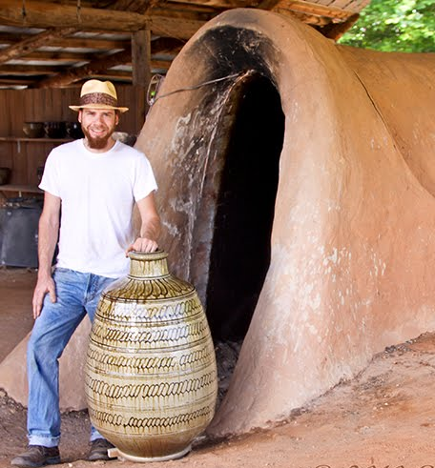
Questions?

Slide 16
UNDERGLAZE INFORMATION

Slide 17
Underglaze
Underglaze is colored slip formulated to have low drying shrinkage, allowing application to bone-dry or bisque-fired surface before glazing

Slide 18
Underglaze
You must apply 2-3 even coats for the color to be consistent and not streaky
Underglaze can be applied anywhere to your pot-inside, outside, on the bottom.
If clear glaze is not applied on top of underglaze and it’s fired, the finish will be matte, rough and still porous = non functional (cannot eat/drink out of it).
The bottle should say UNDERGLAZE or COVERCOAT

