Slide 1
Self Studies
Art 2

Slide 2
Preparation
In order to prepare for the midterm self portrait project, we will be creating studies to help better prepare ourselves to create an accurate, interesting and well made self portrait.
What are “studies”?
In art, a study is a drawing, sketch or painting done in preparation for a finished piece, or visual notes. Studies are often used to understand the problems involved in drawing subjects and to plan the elements to be used in finished works such as light, color, form, perspective, and composition.

Slide 3
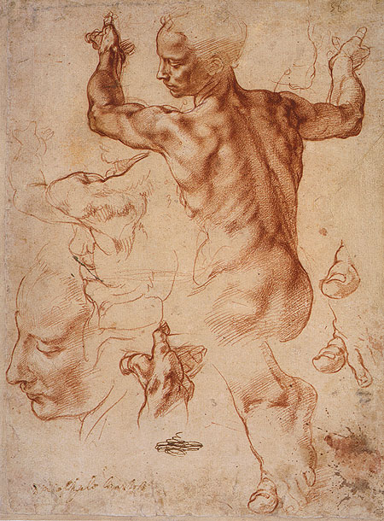

Slide 4
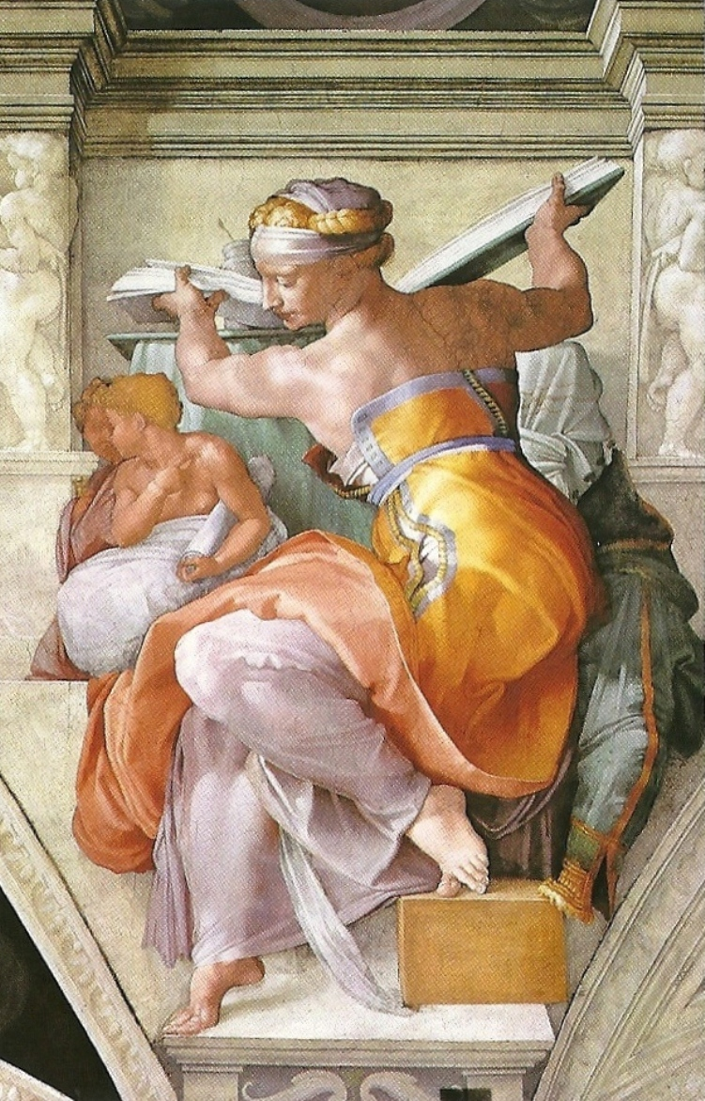

Slide 5
Studies of your face
You will create 6 studies of your face.
Media to choose from:
Watercolor
Pencil/ebony
Sharpie
Tempera
Water-based oil paint
Tissue paper, modge podge, acrylic (mixed media)
Watercolor pencil
Out of the 6 studies, you must have atleast 1 study of an eye, nose, mouth
Options:
Just one facial feature per study
2 facial features per study

Slide 6
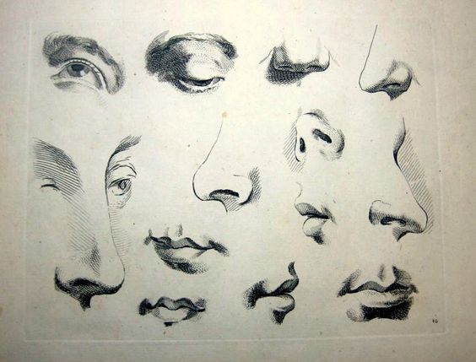

Slide 7
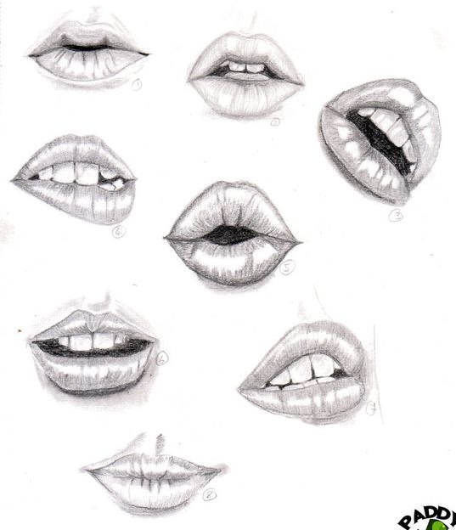

Slide 8
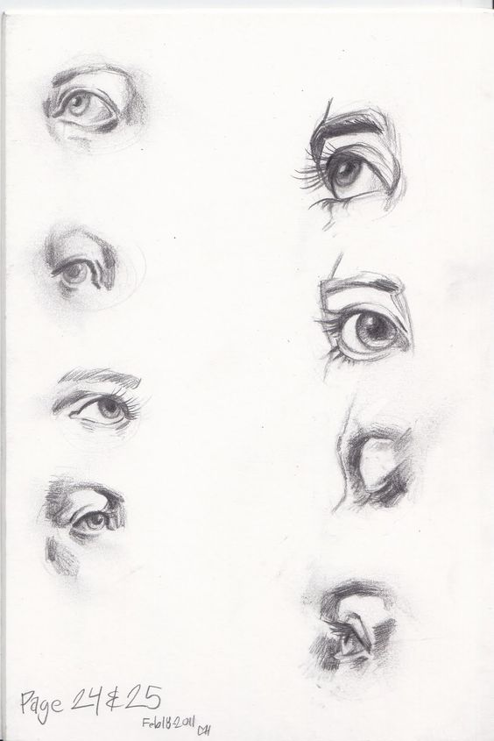

Slide 9
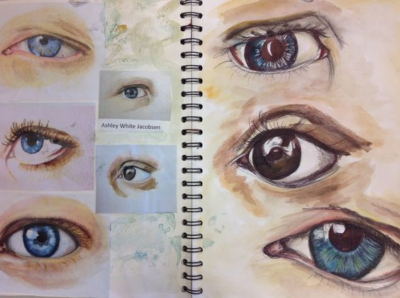

Slide 10
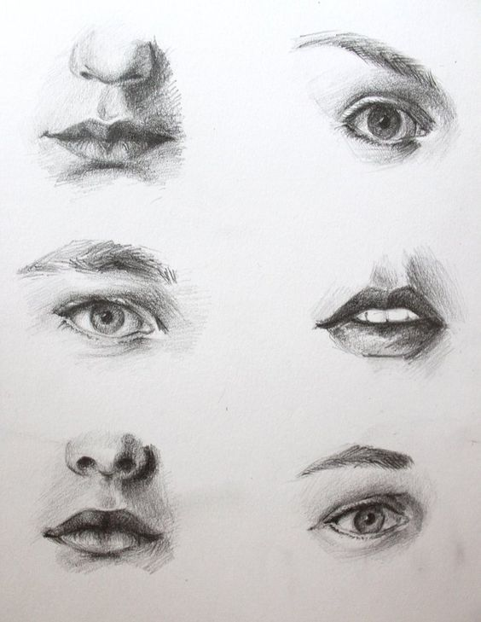

Slide 11
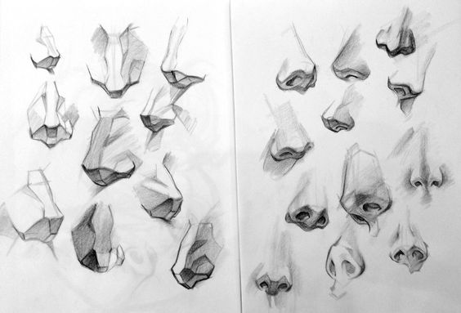

Slide 12
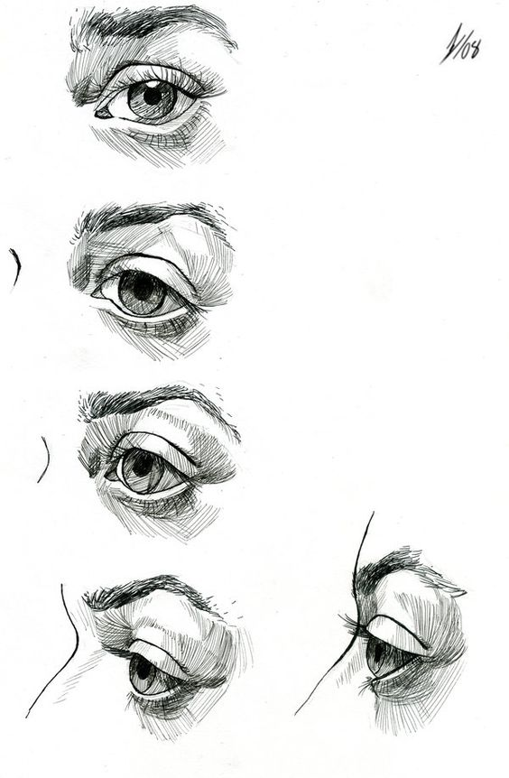

Slide 13
Dividing your paper
You will divide your paper into 6 squares, each 5”x 5” by lightly drawing with HB pencil. Drawing lightly will allow you to erase the pencil later.
It’s recommended you try different media!
Experiment with different application styles!
This is to help you explore, experiment and prepare for the mid term

Slide 14
5”
5”

Slide 15
Grading and Due Date
Each study is worth 15 points
Total project: 90 points
Due Date: December 8th (you can complete 1 study per day at the bare minimum)

