Slide 1
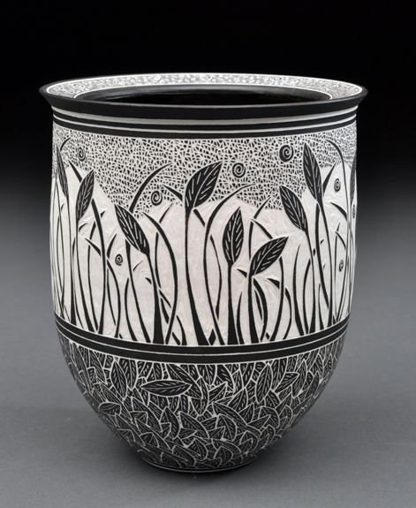
Sgraffito Project Examples
Ceramics

Slide 2
What is sgraffito?
By definition: (in Italian “to scratch”) is a decorating pottery technique produced by applying laters of colored slip (underglaze) to leather hard pottery and then scratching off parts of the layer to create contrasting images, patterns and texture and revewal the clay color underneath.

Slide 6
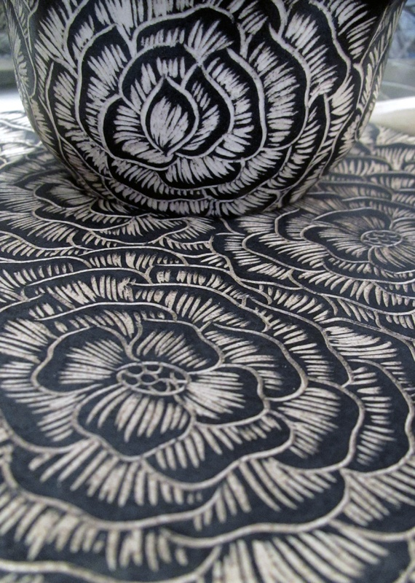
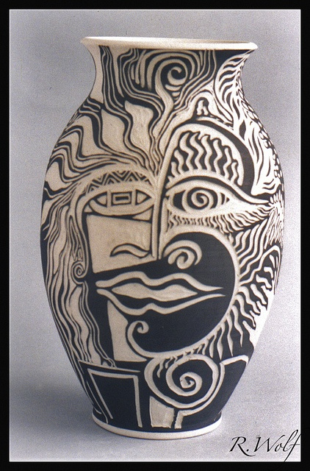

Slide 7
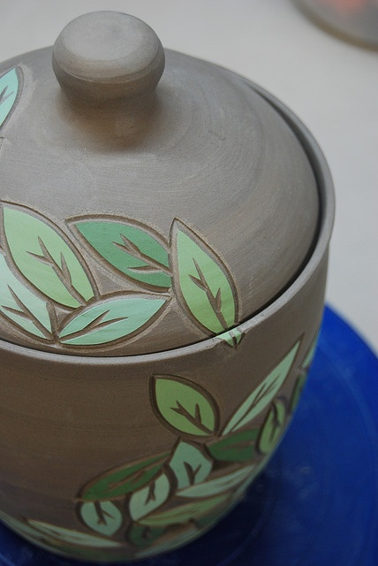
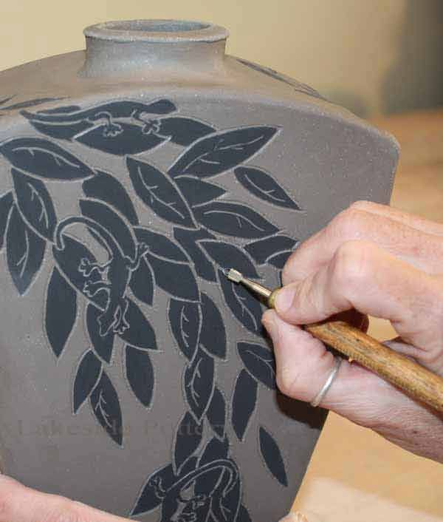

Slide 8
How to choose colors
Masks should be bright/colorful like the Oaxacan masks you’ve been shown
Doodles/Zentangles will be drawn into the underglaze.
Choose areas to block in different colors.
Cheeks
Forehead
Ears
Chin
Horns

